Slide 1
Toastmasters Education Program & Resources 演講會的進階課程和資源平台 Helen Chen, DTM Feb. 22, 2014

Slide 2
傑出會員DTM
Distinguished Toastmaster
(DTM)
Leadership
領導
???
進階會員
???
Communication
溝通
Competent Communicator
CC 中級演員員
New Member 新會員
Notes:
Before I get started, I usually like to take a quick survey. It’s important for a speaker to know your audience.
DTM?
Advanced member?
Finish CC?
Working on CC?
Joined within the last 6 months?
When I first joined Toastmasters 13 years ago as a new member, I was just as confused as most of you. I received the CC manual and I thought it would take a long time before I finished the first 10 speeches. I knew there were some members who were advanced members and I knew Toastmasters was about Leadership and Communication, but I didn’t know very much other than these basic facts.
I delivered a speech every month so I was able to finish the CC manual within a year. Then I learned that the Advanced level was not the highest level. There was this thing called the DTM. I was curious how to get there so I started to look. The more I looked, the more I got confused. There were all kinds of requirements. Because I wanted to figure out what I needed to get to the next level, I put together a chart for myself so I could keep track of my own progress. After I have gone through the whole program, I wanted to share what I discovered about the Toastmasters program with all the members. It’s not as hard as you think, but it could get pretty confusing.

Slide 3
Distinguished Toastmaster
(DTM)
Advanced Communicator
AC - Gold
communication
完成任二本進階手冊
指導一位新會員/ 主持二項課程
Advanced Communicator
AC -Silver
完成任二本進階手冊
主持二項課程
Advanced Communicator
AC -Bronze
完成任二本進階手冊
中級領導課程
(CL)
中級溝通課程
(CC)
Basic Leadership Manual
Basic communication manual
新會員
Notes:
Everyone starts off as a new member and if you joined within the last 4 years, you received 2 manuals. One for communications and one for leadership. After finishing the first 10 speeches, you deliver 10 more speeches to get to the next level, 10 more to the next level and then 10 more to get to AC Gold. Pretty straight forward.

Slide 4
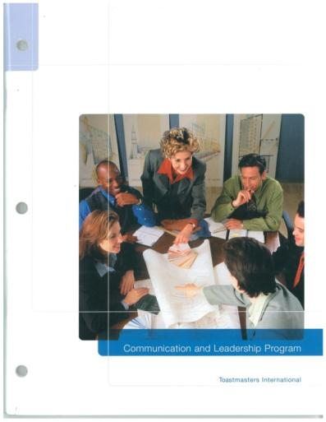
Competent Communication Manual 中級溝通手冊（ＣＣ）
Ice Breaker
Organize your speech
Get to the point
How to say it
Your body speaks
Vocal Variety
Research your topic
Get Comfortable with visual aids
Persuade with Power
Inspire your audience
Notes:
There are 10 projects within the first Competent Communication Manual. These projects are designed for a new member to develop fundamental speaking skills and to discover their own speaking styles. Unfortunately, only 30% of all new members persist and stay with the organization to finish the first 10 speeches. I think it’s really too bad because the fun starts after you have finished these 10 speeches.

Slide 5
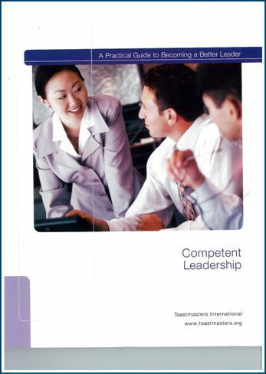
Competent Leadership Manual 中級領導手冊 (CL)
Listening and Leadership
Critical Thinking
Giving Feedback
Time Management
Planning & Implementation
Organization & Delegating
Developing facilitation skills
Motivating People
Mentoring
Team Building
Notes:
The leadership manual features 10 projects, each focused on developing a leadership skill, such as listening, motivating and team building.
Each project requires you to serve in one or more meeting or club roles that will help you learn and practice that skill.

Slide 6
Communication Programs
Competent Communication Manual
10 Projects
中級溝通手冊
Advanced Communication Manual
Total 15 Manuals
進階手冊 15本
Notes:
After you finish your communications manual, you can select 2 advanced manuals from a list of 15 and Toastmasters will mail them to you: FOR FREE.

Slide 7
Advanced Communication Manual 進階手冊 15本
Entertaining speaker
Speaking to inform
Public Relations
Discussion leader
Specialty speeches
Speeches by Management
Professional Speaker
Technical presentations
Persuasive speaking
Communicating on TV
Storytelling
Interpretive Reading
Interpersonal Communication
Special Occasion speeches
Humorously Speaking
Notes:
There are 15 advanced manuals for you to develop your speech skills. They cover a wide range of speaking types, occasions, and purposes.

Slide 8
Advanced Communication Manual 進階手冊 中文6本
CT226A The Entertaining Speaker
(Traditional Chinese)娛樂型演講
CT226B Speaking to Inform
(Traditional Chinese)資訊型報導
CT226G The Professional Speaker
(Traditional Chinese)職業演講者
CT226I Persuasive Speaking
(Traditional Chinese)勸說型演講
CT226K Storytelling
(Traditional Chinese)故事講述
CT226O Humorously Speaking
(Traditional Chinese)幽默式演講
Notes:
There are 6 advanced manuals that have been translated to Traditional Chinese.

Slide 9
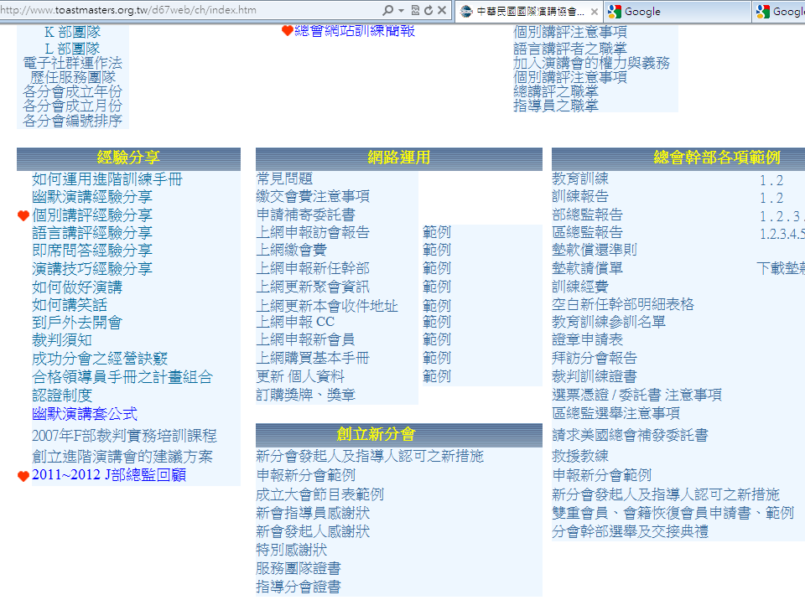
Notes:
To help you select which 2 manuals, or which 6 manuals you would like to try, there is a wonderful link on the Chinese page of the D67 website. This was an article written by Howard Chang. He suggested 3 different ways for you to select the advanced manuals.

Slide 10
Notes:
You can read his full article online

Slide 11
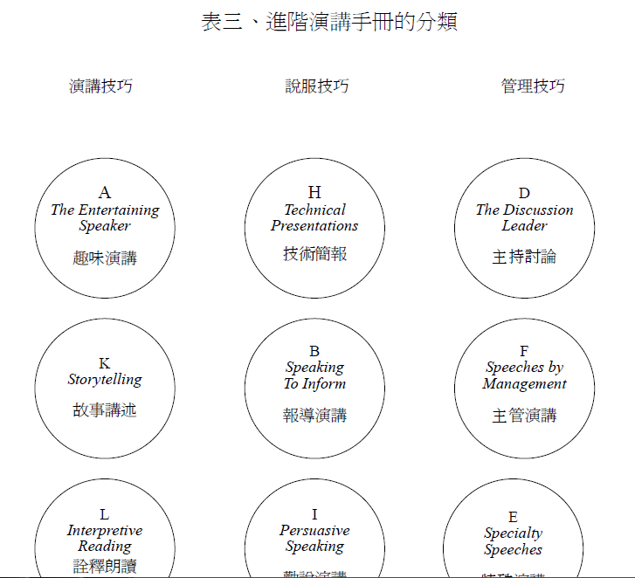
Notes:
He divided the 15 manuals into 3 categories, those for speaking, those for persuasion, and those for management. You can also divide the manuals into 2 categories: for personal interest, or for your professional career. And lastly, is this skill urgently needed in your life, or is it something you can develop over time. These diagrams are all available for download.

Slide 12
Distinguished Toastmaster
(DTM)
Advanced Leader –Silver (ALS)
Leadership
擔任地區總會幹事一年 完成《高成效領導課程》
擔任新會發起人/新會指導人或救援教練
Advanced Leader – Bronze
(ALB)
擔任分會幹部六個月/參加幹部訓練
主持二項課程
中級領導課程
(CL)
中級溝通課程
(CC)
Basic Leadership Manual
Basic communication manual
New Member新會員
Notes:
The Leadership Track is very similar in structure to the communications track. You serve as a club officer and then as area or division governor.

Slide 13
Distinguished Toastmaster
(DTM)
communication
Advanced Communicator
AC - Gold
Advanced Leader –Silver (ALS)
完成任二本進階手冊
指導一位新會員/ 主持二項課程
Leadership
擔任地區總會幹事一年 完成《高成效領導課程》
擔任新會發起人/新會指導人或救援教練
Advanced Communicator
AC -Silver
Advanced Leader – Bronze
(ALB)
完成任二本進階手冊
主持二項課程
Advanced Communicator
AC -Bronze
擔任分會幹部六個月/參加幹部訓練
主持二項課程
完成任二本進階手冊
Basic Leadership Manual
Basic communication manual
New Member新會員
Notes:
If we combine the two tracks together, you will noticed that there are a few requirements for “Presentations” in both tracks. I found that trying to figure out which presentations to deliver at each stage was the most confusing part about the Toastmasters program. After my research from a variety of sources, I organized the related manuals into a chart.

Slide 14
Educational Series 訓練課程
SUCCESSFUL CLUB (ACS/ALB)
LEADERSHIP EXCELLENCE (ALB)
BETTER SPEAKER (ACS)
SUCCESS / LEADERSHIP (ACG)
SUCCESS / COMMUNICATION (ACG)
成功會務系列
傑出領導系列
演講精進系列
成功/領導課程
成功/溝通課程
High Performance Leadership (ALS)
Youth Leadership (ACG)
Youth Interpersonal Communication
高成效領導課
青少年領導課程
青少年人際溝通課程
Notes:
I sorted the types of educational series and finally found a way to understand them. The first 5 are series, they each contain 10-15 presentations on various topics. 6-8 are unique in themselves. Notice how the same words keep showing up? Toastmasters International really wants every member to be successful, that’s why success is used in these titles. The titles also seem to circle around the same words such as leadership, communication and speaker. To distinguish between these, I discovered that the key les in the “slash” after the word Success. If there is a slash in the series, then they are different from those without the slash

Slide 15
& &
1
2
3
Script Outlines Ready
Slides (ppt) Ready
10-15 minutes
Suitable for club meetings
Recommended for Club Officers/Area Gov.
No Evaluators Needed
Digital Versions FREE

Slide 16
Educational Series 1. THE SUCCESSFUL CLUB SERIES 成功會務系列 (ACS and ALB)
Moment of Truth關鍵時刻
Finding New Members for Your Club尋找新會員
Evaluate to Motivate激勵式講評
Closing the Sale促銷技巧
Creating the Best Club Environment創造例會最佳環境
Meeting Roles and Responsibilities例會成員職責
Mentoring新會員指導
Keeping the Commitments信守承諾
Going Beyond Our Club分會以外活動
How to be a Distinguish Club如何成為傑出分會
The Toastmasters Education Program國際演講會教育課程
Notes:
The First Series is about Club operations and how to make your club more successful. This is the most commonly heard presentations at clubs in Taiwan. Presentations from this series qualify for both the ACS and ALB.

Slide 17
Educational Series 2. THE LEADERSHIP EXCELLENCE SERIES 傑出領導系列 (ALB)
The Visionary Leader 有遠見的領導者
Values and Leadership 價值與領導
Delegate to Empower 授權分工
Giving Effective Feedback 提供有用回饋
Motivating People 激勵人心
Resolving Conflict 解決紛爭
Developing a Mission 發展任務
Goal Setting and Planning 目標設定和規劃
Building a Team 組織團隊
The Leader as a Coach 領導如教練
Service and Leadership 服務與領導
Notes:
Series 2 is all about Leadership. This is the least delivered presentation among the 3 series because it only fulfills the ALB award. These are all wonderful topics related to leadership. Obviously, you cannot deliver a comprehensive presentation on motivating people in 15 minutes. The purpose for these presentations is for you to become aware of the specific areas related to leadership. After you learn the content and share it with your members, you will have had some knowledge. This experience will help you to be more observant in the future when you read about the different topics. For example, when I read magazine articles related goal setting and planning, I clip it out and file it with my materials on this topic.

Slide 18
Educational Series 3. THE BETTER SPEAKER SERIES 演講精進系列 (ACS)
Beginning Your Speech 如何開始演講
Concluding Your Speech 如何結束演講
Take the Terror Out of a Talk 消除演講恐懼
Impromptu Speaking 即席演講
Selecting Your Topic 選擇題材
Know Your Audience 了解聽眾
Organizing Your Speech 組織講稿
Creating an Introduction 撰寫引介辭
Preparation and Practice 撰稿與演練
Notes:
The 3rd series is all about speaking skills. Most TM members are most interested in these topics and they are fantastic ways to design special meetings to attract guests and provide opportunities for new members to improve basic speaking skills to complement the CC manual. If you pick one and conduct a presentation, you will benefit the most because you will be able to incorporate the techniques into your own speeches right away.

Slide 19
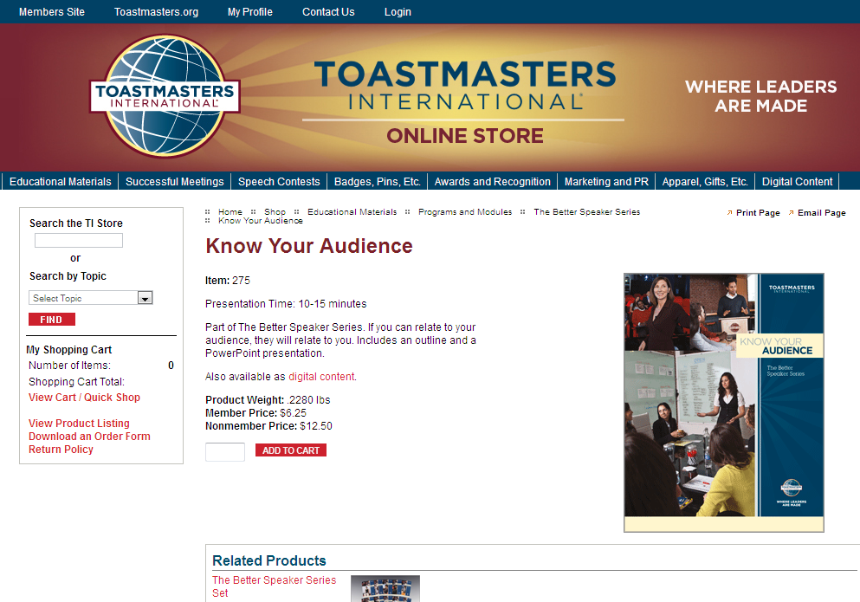
Educational Series 3. THE BETTER SPEAKER SERIES 演講精進系列 (ACS)
Beginning Your Speech 如何開始演講
Concluding Your Speech 如何結束演講
Take the Terror Out of a Talk 消除演講恐懼
Impromptu Speaking 即席演講
Selecting Your Topic 選擇題材
Know Your Audience 了解聽眾
Organizing Your Speech 組織講稿
Creating an Introduction 撰寫引介辭
Preparation and Practice 撰稿與演練
$6.25
+ shipping
Notes:
I was interested in finding out how much each presentation will cost today, so I looked online and picked “Know your Audience”. Each presentation costs US$ 6.25 plus shipping. The cost is not extraordinary, but shipping can be outrageous. Often times, the cost of the postage is more than the item itself! All the presentations are available in printed form in the online store.
Some women are crazy about Shoes, Some women are crazy about bags. Guess what I am crazy about? My hobby is shopping in the TI online store for educational materials. I am serious. My bookshelf is full of manuals and handbooks from Toastmasters. When I am in the online store, I cannot control myself.

Slide 20
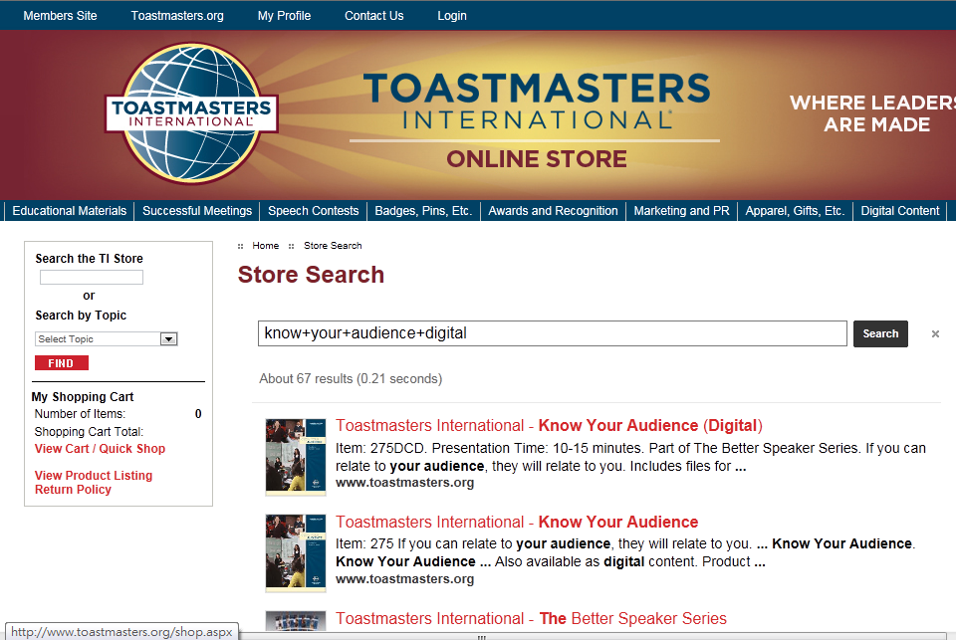
Notes:
While I was in the online store, I noticed that there was an option for the digital version. So what did I do? Naturally, I clicked on it.

Slide 21
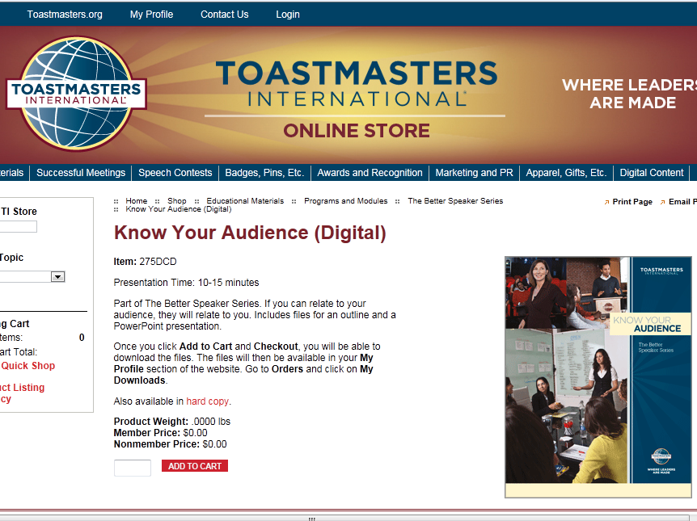
Notes:
Guess what I found? I looked to see how much it would cost, expecting it to be a little cheaper than the printed version. Oh my god, Member price is US$ 0 !! This is unbelievable. Without hesitation, I added it to my shopping cart!!

Slide 22
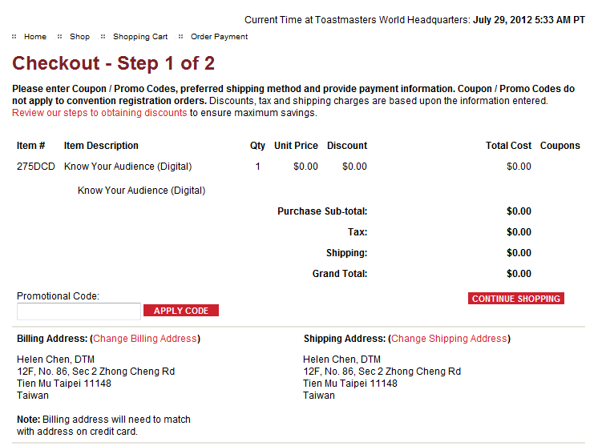
Notes:
Look at the Total Cost: $ 0 for the item, $0 for tax. $0 for shipping. And the Grand total is also $0. It won’t get any cheaper than this. Let’s continue shopping.

Slide 23
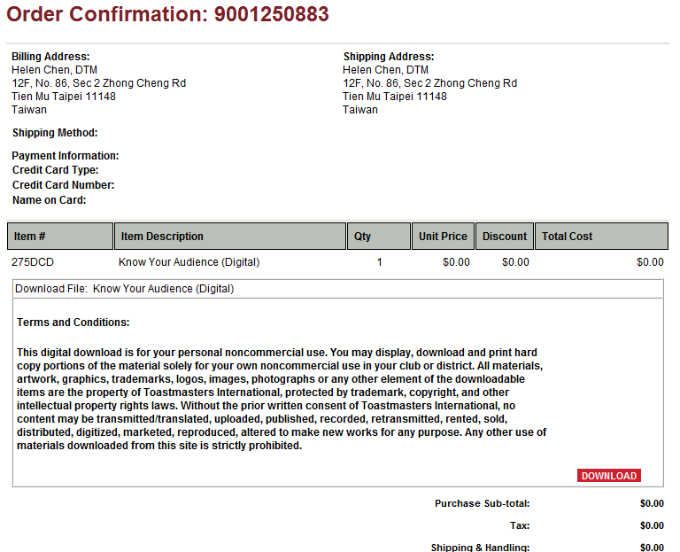
Notes:
That’s the right address for shipping, and yes, please bill me for this item. Now we are ready to download this presentation.

Slide 24
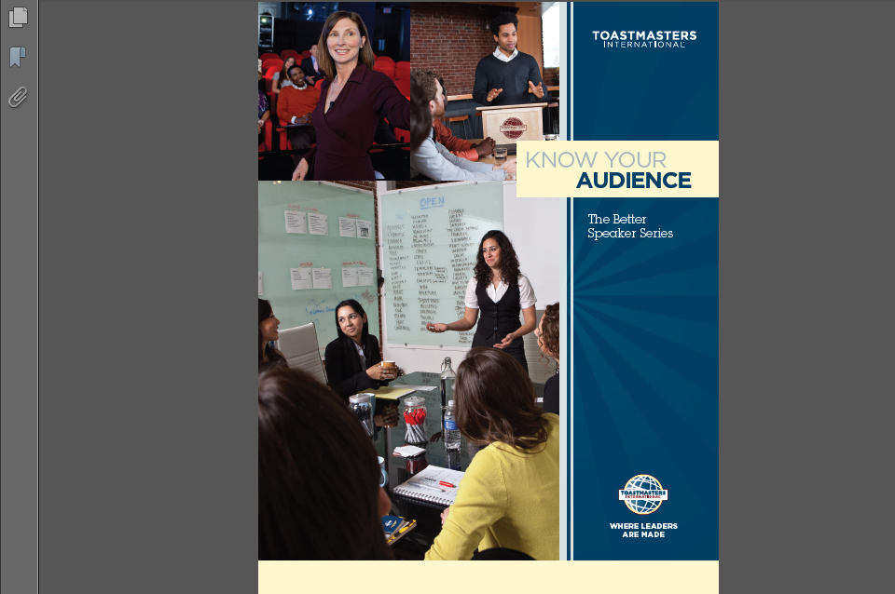
Notes:
So what do you get for paying zero dollars for?
You get two files: a pdf and a powerpoint slide
This is what your script outline will look like.

Slide 25
Notes:
These are the main points related to this topic. The purpose for delivering these presentations is not for you to research and collect information to write your own content. The purpose is for you to learn the content and share them with an audience. Toastmasters has done half the work for you. There is an outline with key points so you can use your own language to cover this topic.

Slide 26
Know Your Audience
The Better Speaker Series
275
Notes:
This is what the powerpoint presentation slides look like. There are only 5 slides. These are not fancy slides. The idea is for you to take this and use it without having to spend too much time on the slides. There is no need to add animation and images, unless you feel that they are absolutely necessary.

Slide 27
Notes:
The bullet points in each slide match the script outline.
When I first joined Toastmasters 13 years ago, these presentations came with transparencies. How many of you have NEVER seen this before and have no idea what this is for? I am afraid I am dating myself here. Back in the dark ages 10 years ago, we used a machine to project light through these transparent pages, so audience could see the writing on the large screen. These soon became outdated.
About 5 years ago, TI finally caught up with the rest of the world and created very basic powerpoint slides. Your purchase included a CD and script outlines. I have seen different versions of these powerpoint presentations. Some of them didn’t look very good so I actually typed and created my own slides a few times.
Now, you can download the slides for free and get the script for free too!

Slide 28
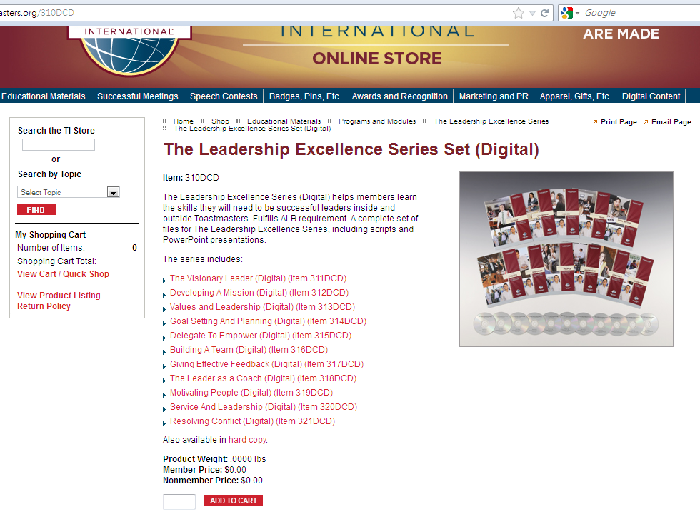
Notes:
When I looked further in the online store, I noticed that there was an option to download the whole series for free! Now I don’t have to download each individual presentation. Toastmasters International is really thoughtful. Just think how much time that will help us save!
You might take this for granted now, but imagine the money I paid for all those presentations that are sitting on my bookshelf!

Slide 29
Don’t just download the files !! 下載 （練習） Deliver these presentations!! 上台
Notes:
Don’t just download and save the files on your computer’s hard drive. These presentations are not designed for you to read them. Being Toastmasters, you all know that we learn by doing. The purpose is for you to learn the content and actually deliver and share them. This is a lot easier than writing your own speeches. Although the time suggested for each is 10-15 minutes, which is twice as long as a normal C level speech, it’s not as hard as you think. Trust me, you will learn so much more after you conduct these presentations.

Slide 30
4. THE SUCCESS/LEADERSHIP PROGRAMS 成功/領導課程 (ACG)
How to Conduct Productive Meetings
如何有效主持會議
Improving Your Management Skills
增進你的管理技巧
Parliamentary Procedure in Action
議事規程實務
Building Your Leadership Power
培養領導能力
I. Characteristics of Effective Leaders
有效領導者的特質
II.: Developing Your Leadership Skills
發展你的領導技巧
III. Working in the Team Environment
在團隊環境下工作
Notes:
Now moving on to Series 4 & 5. Notice the slash between Success and Leadership. These topics are more complex.

Slide 31
5. THE SUCCESS/COMM. PROGRAMS 成功/溝通課程 (ACG)
Speechcraft 演講訓練營
How to Listen Effectively 如何有效聆聽
The Art of Effective Evaluation有效講評的藝術
From Speaker to Trainer 從演講人到訓練人
Building Your Thinking Power培養思考能力
I. Mental Flexibility彈性思考
II. The Power of Ideas創意的威力
Notes:
I selected the “how to listen effectively” presentation because I felt that all the way until this stage, there was nothing in the Toastmasters training program related to listening. Since we are always speaking, someone’s got to listen. I wanted to learn to be a better listener, that’s why I choose this topic. It was before the leadership manual was published and sent to every new member. Today, if you looked in the leadership manual, the first project is Listening.

Slide 32
&
4
5
Purchase from TI Online Store: Not Free
Whole packages available
A Coordinator’s Guide
Workbooks for attendees
Certificates
Evaluation Guide to collect feedback
Interaction between trainer/participants
At least 1 hour
Suitable for division/district/special workshops
No Evaluators Needed
Notes:
The common characteristics about series 4 & 5 is that they are very much different from the previous three. And they are not for free. Although an evaluator is not required for completion of the project, an evaluation guide is provided for you to hand out to your participants, so you can collect feedback for your reference. It’s always a good practice for Toastmasters to arrange for evaluators so we can make improvements on our performance.

Slide 33
High Performance Leadership (HPL) 高成效領導課
Notes:
HPL is a very unique and special project. You can find out about this from the website

Slide 34
Youth Leadership Program 青少年領導課程
Notes:
The Youth Leadership Program is also an interesting set to try.

Slide 35
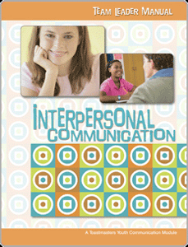
Youth Interpersonal Communication Program 青少年人際溝通課程 **Do not fulfill any award requirements
Notes:
Recently TI released a new set of programs called Youth Interpersonal Communication Program, aimed at providing guidelines for members to work with teenagers to help them develop communication and leadership skills. Unfortunately, delivering this program will not give your any credit toward any educational awards.

Slide 36
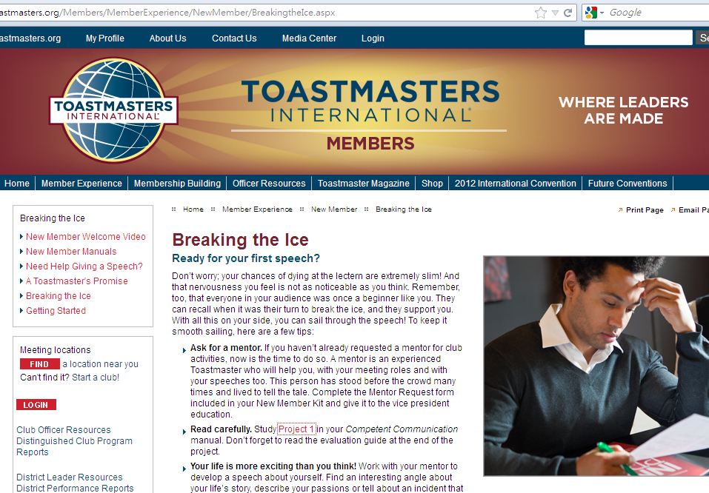
Notes:
There is a wonderful section on the TI website for new members. It’s got links to resources and content just for new members, including the pdf file of the first speech: breaking the ice. If you are an officer, you can download this and send it to your new member right after they paid. Because they won’t get their manuals until 3 weeks later, it makes them feel better if they receive something right away after they pay. You can also help them get started so they can read about the project while they are listening to other speakers, especially other C1 speakers in your club.

Slide 37
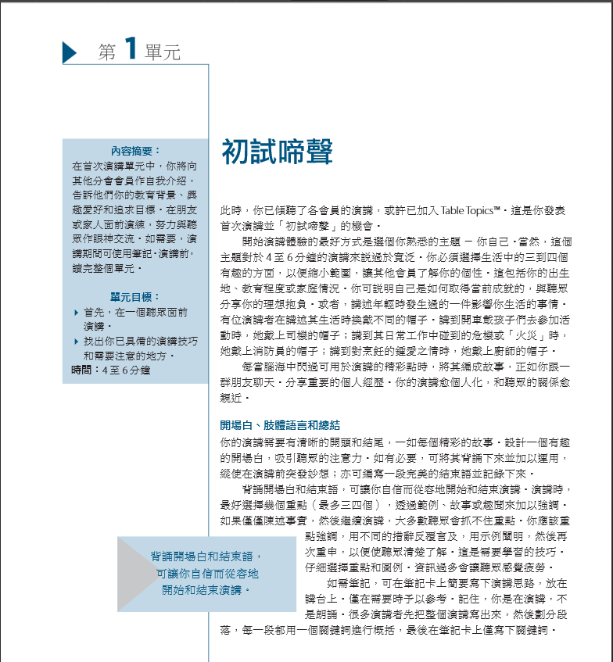

Slide 38
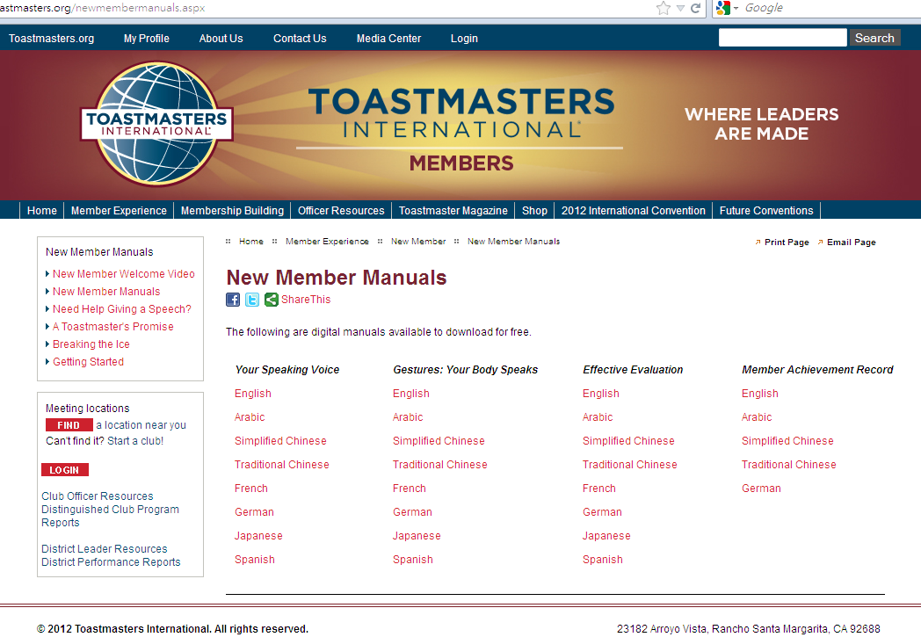
Notes:
There are also 3 small booklets that used to be sent to all new members. Now toastmasters offers them online in pdf format. You will still receive them, after you finish the first 10 speeches. The three booklets will be sent with your 2 advanced manuals. If you want to read them, they are available online, even in Traditional Chinese.

Slide 39
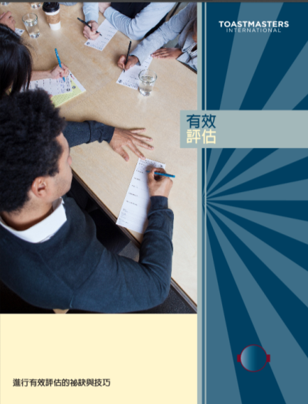

Slide 40
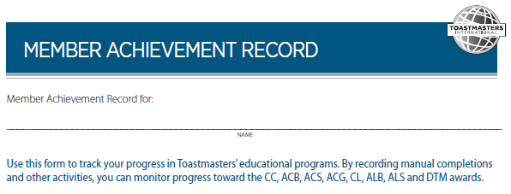

Slide 41
Other manuals ($$)

Slide 42
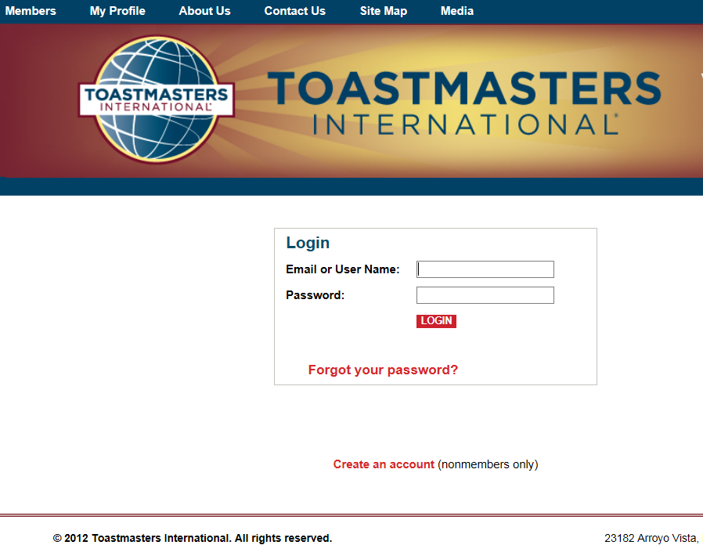
Notes:
The Online store requires you to login as a member before you can purchase digital materials.

Slide 43
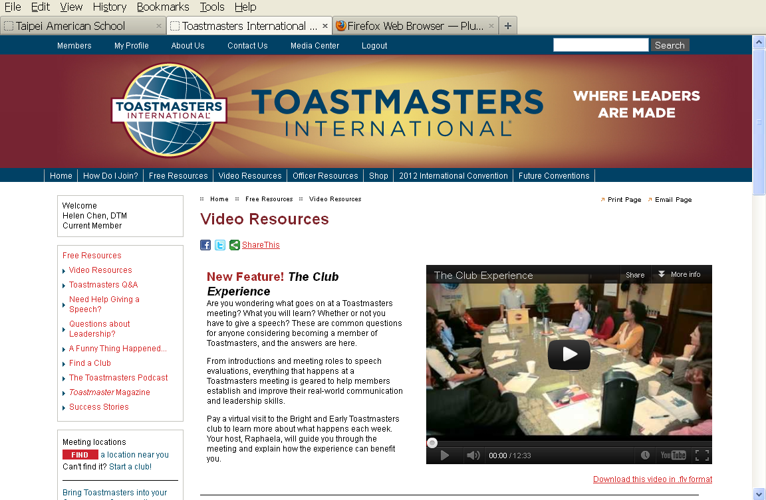
FREE Resources !!
Notes:
I was very excited to stumble upon this section called “Free Resources”. Oh my, Toastmasters is just so amazing. They know how hard I have worked trying to find free material online. They decided to group some of them together. They include video and Q&A. These are not part of the online store materials so you can access them from the website.

Slide 44
Distinguished Toastmaster
(DTM)
Advanced Communicator
AC - Gold
communication
Advanced Leader –Silver (ALS)
Advanced 10 speeches
1 seminar+ coach new member
Leadership
governor + HPL
Club sponsor/mentor
Advanced Communicator
AC -Silver
Advanced Leader – Bronze
(ALB)
Advanced 10 speeches
2 programs
Advanced Communicator
AC -Bronze
Club officer + 2 programs
1 officer Training
Advanced 10 speeches
Competent Leader (CL)
Competent Communicator
CC
Basic Leadership Manual
Basic communication manual
New Member
Notes:
In order to complete the leadership track, you need to serve as a club officer and then as a district officer.

Slide 45
Distinguished Toastmaster
(DTM)
communication
Advanced Communicator
AC - Gold
Advanced Leader –Silver (ALS)
完成任二本進階手冊
指導一位新會員/ 主持二項課程
Leadership
擔任地區總會幹事一年 完成《高成效領導課程》
擔任新會發起人/新會指導人或救援教練
Advanced Communicator
AC -Silver
Advanced Leader – Bronze
(ALB)
完成任二本進階手冊
主持二項課程
Advanced Communicator
AC -Bronze
擔任分會幹部六個月/參加幹部訓練
主持二項課程
完成任二本進階手冊
Basic Leadership Manual
Basic communication manual
New Member新會員
Notes:
If we combine the two tracks together, you will noticed that there are a few requirements for “Presentations” in both tracks. I found that trying to figure out which presentations to deliver at each stage was the most confusing part about the Toastmasters program. After my research from a variety of sources, I organized the related manuals into a chart.

Slide 46
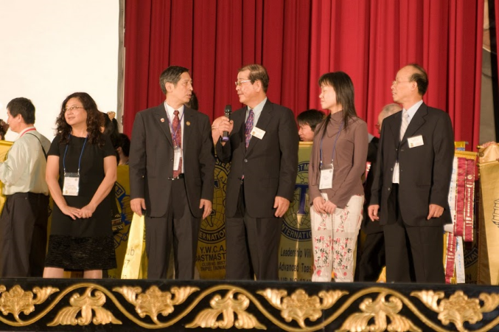
Club/District Offices
Club Officer
Area Governor
Division Governor
Public Relations
Secretary
Parliamentarian
Lt. Gov. Marketing
Lt. Gov. Education
District Governor
International
Notes:
These are the available district positions. We have had many great leaders who contributed their time and efforts to make our organization a better learning environment.

Slide 47
Notes:
There are also resources just for club officers online. The Club Leadership Handbook is available on Traditional Chinese

Slide 48
People 人
Mentors/Club Officers/ Past Presidents
分會幹部/前任幹部
Area/Division Governors 區和部總監
Other clubs 其他分會
Senior Toastmasters 資深會員
Active Toastmasters 非常活躍的會員
DTM 傑出會員
Notes:
Who you can call on for help:

Slide 49
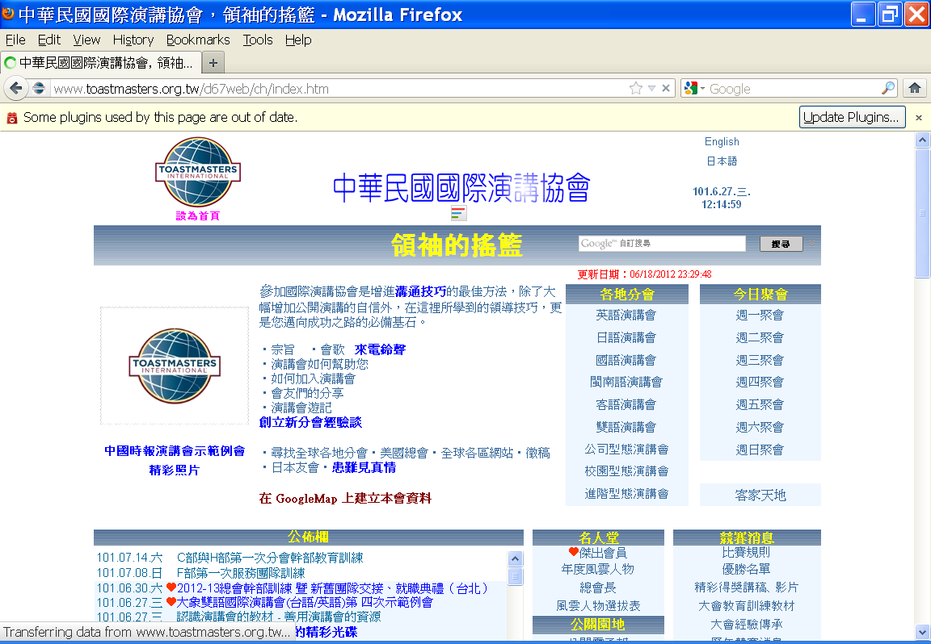
Notes:
You can find a list of DTM our D67 website. DTMs are obligated to answer your questions and help you with your projects. Because we have benefited so much from the support we have received, it’s time that we return the service to others.

Slide 50
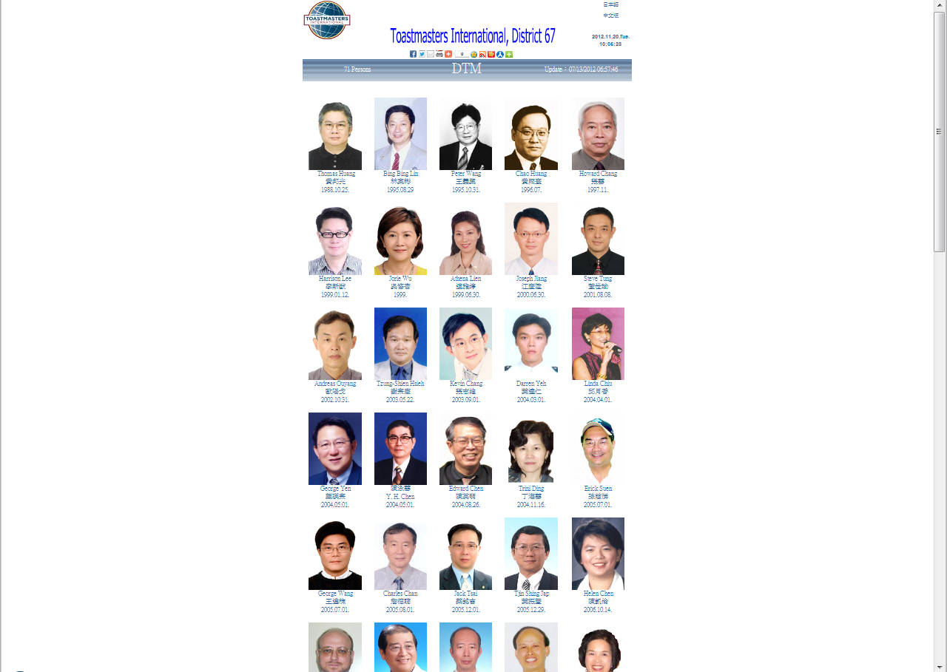

Slide 51
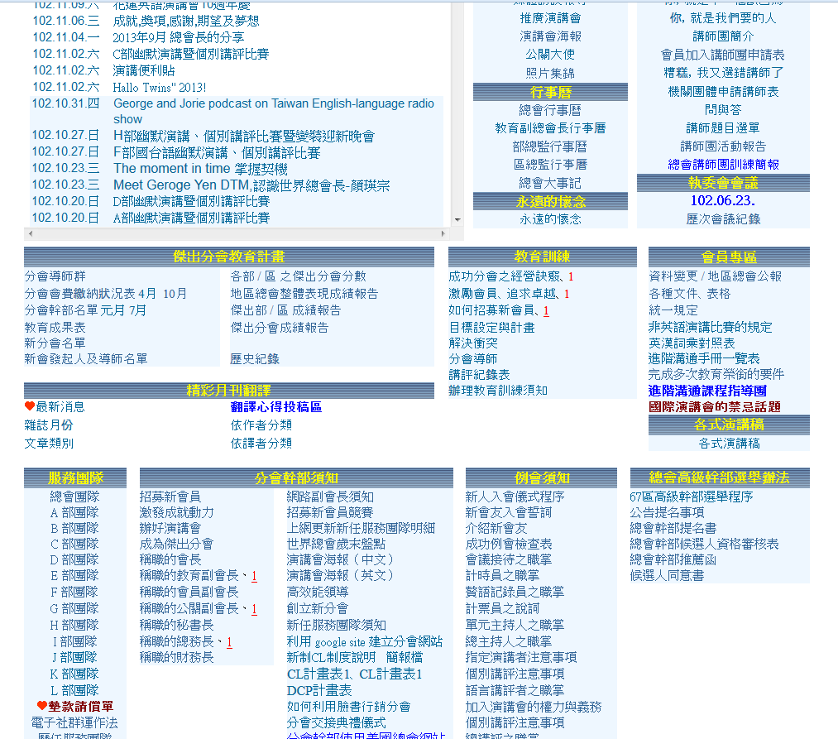
Notes:
The best kept secret on this D67 website is a link that no one knows existed. It’s available on both the English and Chinese versions. It’s called the Advanced Program Mentor.

Slide 52
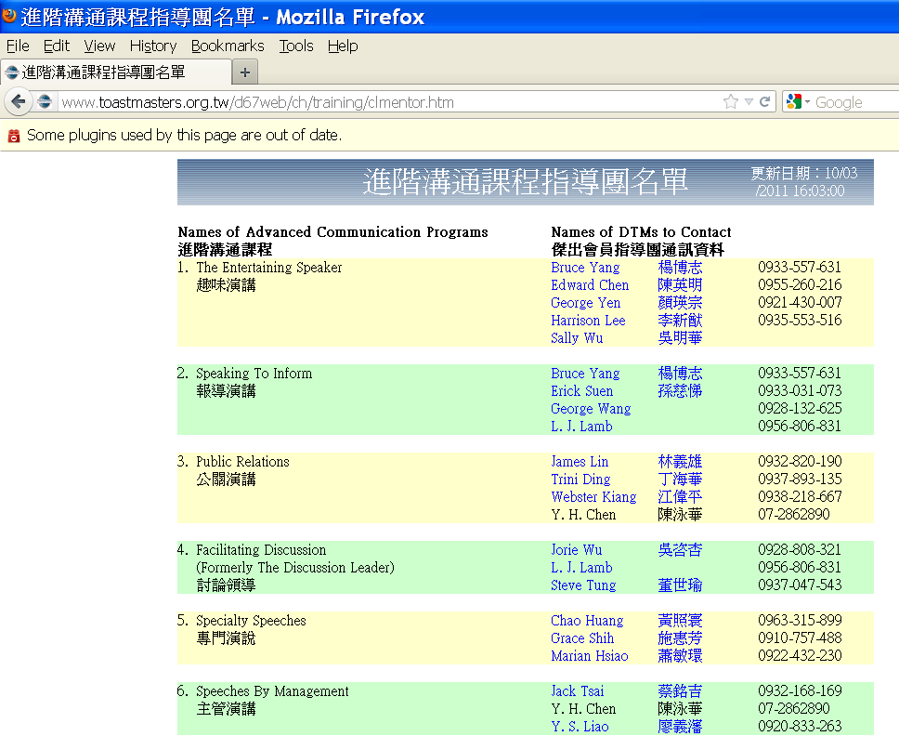
Notes:
A few years ago, the district asked all the DTM which 2 advanced manuals they are most comfortable delivering and would be willing to offer assistance to other members interested in those manuals.

Slide 53
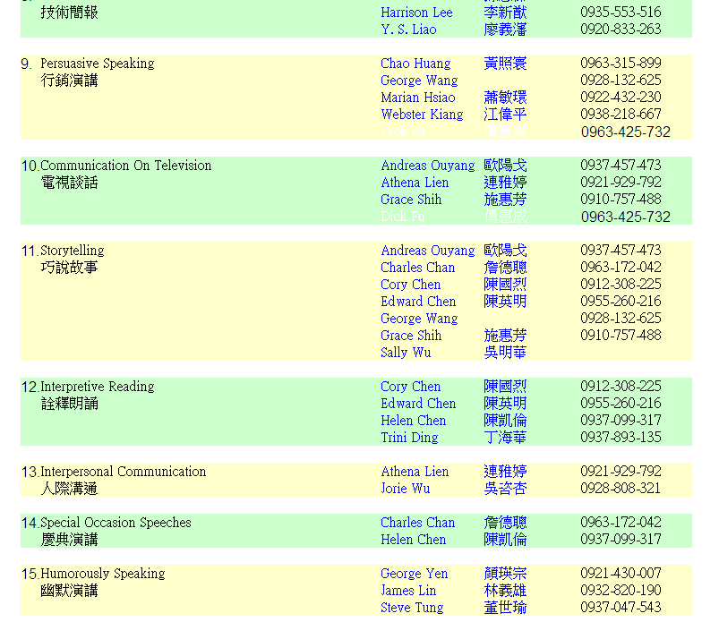
Notes:
I picked #12 and #14. Notice that for every manual, there are at least 2 DTM you can call for help. If you have trouble understanding the projects, these DTM are there to offer their advice. This is a wonderful resource. Since my name and my mobile phone number were listed, I am very disappointed no one has called me. My favorite advance manual is Special Occasion Speeches because there is a speech about making a toast. I think every Toastmaster should try to deliver a toast at least once, otherwise we cannot call ourselves masters of toast = Toastmasters. But that’s the topic of a different wokshop.

Slide 54
Venues 場合
Club meetings 例會
Special Programs (workshops) 特別活動
Educational Training sessions 教育訓練
Division Officer Trainings 幹部訓練
Fall/Spring District Conferences 地區大會
Speaker’s Bureau 講師團
Summer youth programs
暑假青少年學習營
Speech Craft / Mini-Toastmasters
演講訓練營/迷你演講會
Notes:
I have told you a variety of manuals and projects within the Toastmasters program. You learned about the different educational series, you also know who to go to for help, now you must be wondering where you can deliver these speeches and presentations. Depending on what you are presenting, the appropriate venue will need to be carefully considered. As you become a more advanced speaker, you will need a larger audience who will benefit from your content, and you can also gain more confidence in bigger settings.

Slide 55
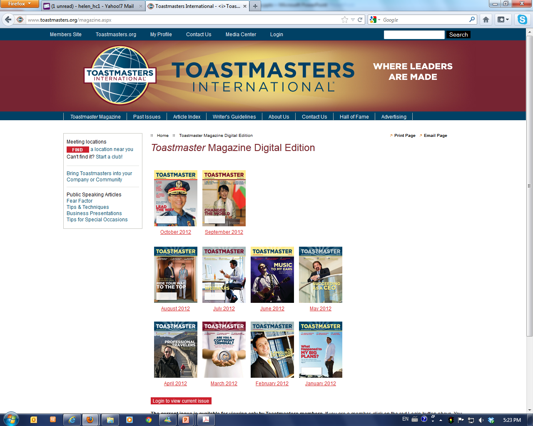
Notes:
Don’t forget the Toastmasters magazines are available in digital formal online. Past issues are also available for download. I know many of our members have had difficulties in receiving your monthly magazines. It’s much better now that you can just download them.

Slide 56
Distinguished Toastmaster
(DTM)
Leadership
communication
New Member
Notes:
Today, I shared with you a variety of resources focusing on the what, who, and where. I hope I have clarified your confusion about what is required for achieving various awards and what the educational series really mean. These are the guidelines and the structures are designed for you to set goals for yourself. Achieving the goals should not be your only purpose. Along the way, you will find out that they are other areas and other speaking opportunities that you might really enjoy. For example, being our conference opening or closing ceremony hosts. I have showed you only some of the resources available on the Toastmaster’s website. Please visit the site and look through the different pages and sections.
If you are a new member, please try the different types of speeches and stay with us, at least until you finish the first 10 speeches. I promise you will have a lot of fun while developing your speaking skills.
If you are a seasoned member, there are lots of new resources online for you to access and experiment further.
If you are a club officer, there are also materials for you to promote your club and resources to help you become a better leader.
I hope you continue to enjoy your journey at Toastmasters and discover that these are rewarding experiences.

