Slide 1
Judges Training
Helen Chen
September 21, 2014
Division C Judges Training

Slide 2
When You Are A Judge 當你是一個裁判時:
You are
A good listener 仔細的聆聽
Knowledgeable 了解比賽
Accurate 精準
Fair 公平
Objective 公正
Trustworthy 可讓人信賴

Slide 3
4 different contests - 4 different criteria – 4 different voting ballots
四種比賽有不同的裁判標準和評分方式
Humorous Speech
幽默演講比賽
Evaluation
個別講評比賽
International Speech
指定演講比賽 World Championship 世界總會大賽
Table topic
即席問答比賽

Slide 5
Contest | Judge Type | Language
Humorous | Chief Judge | English
Evaluation | Voting Judge | Chinese 中文
International | Tie-Breaking Judge | Taiwanese 台語
Table Topic |  | Japanese 日語

Slide 6
Club | Chief judge > 5 judges 1 tiebreaking judge
Area | Chief judge > 5 judges (or equal from each club) 1 tiebreaking judge
Division | Chief judge > 7 judges (or equal from each area) 1 tiebreaking judge
District | Chief judge > 7 judges (or equal from each division) 1 tiebreaking judge

Slide 9
Two Main parts to a Ballot
評分表分兩大部分
For your own reference only
提供裁判給分參考
不列入名次的加分
2) Decide the top 3 winners/No ties
選出前三名,不能有同名次的兩人
Helen Chen
3) Sign and Print your name
寫全名和簽名

Slide 10
Three Main Criteria
Content 50%
內容
Delivery 30%
技巧
Language 20%
語言
Notes:
裁判在上場之前一定要讀懂和清楚的了解評分標準和項目的分數比重分配. 每一個組織舉辦演講比賽都有自己的評分標準. 各個項目的分數比重也都不一樣.

Slide 11
Toastmasters
Rotary
Content 50%
Speech Delivery
Effectiveness
Speech Value
Delivery 30%
Physical
Voice
Manner
Language 20%
Appropriateness
Correctness
Content 30%
Introduction(8)
Objectives (8)
Conclusion (8)
Time (6)
Effectiveness 30%
Achievement of Purpose
Originality
Confidence
Language 40%
Grammar
Appropriate
Pronunciation
Fluency
Notes:
比如說扶輪社的大專英文演講比賽的評分標準和國際演講會就有所不同. 項目不同,分數的比重也不同.裁判需要觀察的方向就會不同. 演講會不把時間列入評分,只要是符合標準內就可以,扶輪社用扣分的方式把事件列入總分的計算.語言的比重也有非常大的不同. 很明顯的可以看得出來演講會重視的是整體的呈現.扶輪社比較重視內容和語言.
The criteria for judging a speech is very different between Toastmasters and Rotary’s College Level English Speech Contest. Toastmaster speeches do not take into account the exact time used, as long as it’s within the minimum and maximum. However, Rotary uses a deduction system and considers time an important criteria. Rotary also places more importance on the use of language compared to Toastmasters. Overall, delivery skills seem to be more important at a Toastmasters contest and words and content more important for winning a Rotary contest.

Slide 12
Three Main Criteria
Content 50%
Delivery 30%
Language 20%
Notes:
Judging a contest is a very personal and subjective decision. We are trying to convert a speech delivery of words into points that we can measure. It’s easier to say you like a speech or you didn’t like a speech. But when you have to rank contestants, according to a set of criteria, this becomes very difficult. Do you know what your perfect speaker looks like? Do you know what 50 points for content sounds like? What is the difference when you give someone 10 or 11 points for a category? Can you justify your own scores?
The job of a judge is to select the top 3 speakers from a contest. Do not compare contestants against their prior delivery. Do not compare contestants to others from previous years.
What do you use as a reference for awarding points? Do you use a world championship speaker as a reference and compare contestants against that standard? Do you use yourself as the reference? Do you use the first speaker as a reference?
It doesn’t matter who you use a reference as long as it’s the same person or the same standard. If you compare every contestant against that, then it’s easier to give higher points or lower points and select your top 3.
Some judges award points very carefully and add up the totals, before deciding who the top 3 winners are. Some judges never award any points, but select their top 3 without calculating total points.

Slide 13
Do you tend to rank on the lower end or higher end?
你填問卷時傾向高分還是低分?
Notes:
When you fill out surveys, do you tend to give out higher points or do you tend to rank everything on the low end? Do you know your own personal style? It doesn’t matter whether you tend to give toward the higher or lower end, as long as you are consistent. If you rank everyone the same on the lowest side, there should still be a difference in total points, because some must still be lower in some items. If you rank everyone really high, you need a way to deduct points so you can determine the top 3 winners. As long as you have your own style and system for making decisions on scoring, then you can be a fair judge.
你知道當你填問卷的時候你通常都給高分還是低分? 你知道你自己的習慣嗎? 其實不管你通常是給高分還是低分,只要你是一致的給分.如果大家都很低分,一定還是有差別,某些人在某些項目一定會比較更低分,這樣你還是可以選出前三名.如果你像我一樣喜歡給高分,那要有一個扣分的機制,不然大家都是滿分也不行.只要你有自己的一套方法,而且在同一場比賽用同一套方法,這樣就可以必較公平的選出前三名.

Slide 14
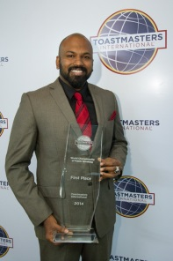
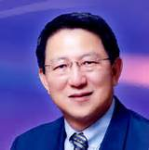
International Speech Contest
100 ？
Judging Item | Excellent
Speech Development | 20
Effectiveness | 15
Speech Value | 15
Physical | 10
Voice | 10
Manner | 10
Appropriateness | 10
Correctness | 10
It’s all relative.
Compare all contestants to the same standard
Notes:
簡單的看看這四個比賽的評分表.評分標準的細項請自己回家研究. 每一個大項目都還有細分得非常明確.有最高分和最低分. 每一個項目給幾分當然有裁判決定.

Slide 16
International Speech Contest
Judging Item | Excellent | Very Good | Good | Fair
Speech Development | 20 | 14-19 | 9-13 | 0-8
Effectiveness | 15 | 11-14 | 6-10 | 0-5
Speech Value | 15 | 11-14 | 6-10 | 0-5
Physical | 10 | 7-9 | 4-6 | 0-3
Voice | 10 | 7-9 | 4-6 | 0-3
Manner | 10 | 7-9 | 4-6 | 0-3
Appropriateness | 10 | 7-9 | 4-6 | 0-3
Correctness | 10 | 7-9 | 4-6 | 0-3
Notes:
簡單的看看這四個比賽的評分表.評分標準的細項請自己回家研究. 每一個大項目都還有細分得非常明確.有最高分和最低分. 每一個項目給幾分當然有裁判決定.

Slide 17
Humorous Speech Contest
Judging Item | Excellent | Very Good | Good | Fair
Speech Development | 20 -> 15 | 12-14 | 10-11 | 0-9
Effectiveness | 15 -> 10 | 8-9 | 6-7 | 0-5
Speech Value | 15 -> 15 | 12-14 | 10-11 | 0-9
Audience Response | 15 | 8-9 | 10-11 | 0-9
Physical | 10 | 8-9 | 6-7 | 0-5
Voice | 10 | 8-9 | 6-7 | 0-5
Manner | 10 | 8-9 | 6-7 | 0-5
Appropriateness | 10 | 8-9 | 6-7 | 0-5
Correctness | 10->5 | 4 | 3 | 2
Notes:
幽默演說和指定演講比賽有哪裡不同?多了聽眾的反應這個項目：１５分。因為多了這個項目，所以要從其他的項目把分數的比重做調整。很多人覺得幽默演說不需要有演講價值，只要好笑就好了。可是評分項目裡占的比重和指定演講是一樣的。所以還是一樣重要。

Slide 18
Table Topics Contest
Judging Item | Excellent | Very Good | Good | Fair
Speech Development | 20 ->30 | 23-29 | 17-22 | 0-16
Effectiveness | 15 ->25 | 18-24 | 11-17 | 0-10
Speech Value | 15 | 11-14 | 6-10 | 0-5
Physical | 10 -> 15 | 11-14 | 6-10 | 0-5
Voice | 10 -> 15 | 11-14 | 6-10 | 0-5
Manner | 10 | 7-9 | 4-6 | 0-3
Appropriateness | 10 | 7-9 | 4-6 | 0-3
Language | 10 -> 15 | 11-14 | 6-10 | 0-5
Notes:
即席演講因為準備時間的關係，所以有些項目就不列入評分，可是還是一個比較簡短的演講，要有布局，效果，聲音和語言。比重也調整過。

Slide 19
Table Topics Contest
Judging Item | Excellent | Very Good | Good | Fair
Speech Development | 20 ->30 | 23-29 | 17-22 | 0-16
Effectiveness | 15 ->25 | 18-24 | 11-17 | 0-10
Physical | 10 -> 15 | 11-14 | 6-10 | 0-5
Voice | 10 -> 15 | 11-14 | 6-10 | 0-5
Language | 10 -> 15 | 11-14 | 6-10 | 0-5

Slide 20
Evaluation Contest
Judging Item | Excellent | Very Good | Good | Fair
Analytical Quality | 40 | 28-39 | 17-27 | 0-16
Recommendation | 30 | 22-29 | 13-21 | 0-12
Technique | 15 | 11-14 | 6-10 | 0-5
Summation | 15 | 11-14 | 6-10 | 0-5
Notes:
講評比賽是一個完全不一樣的比賽，因為是要選出最好的講評員，而不是演講者，所有的評分標準都注重在講評的內容。４０％ 是分析能力。這占總分的一大部分，你知道４０分的分析能力是什麼意思嗎？你覺得他講得有道理，就代表他的分析能力很好嗎？建議暫３０％，要多少建議才夠？越多越好嗎？怎麼樣的結尾你會給他１５分？兩句？三句？

Slide 21
Taking Notes during the speech
The speaker said:
“…..”
Analysis (Comments)
organization
Gestures
Voice
Props
Confusing points
Language / humor
Position/movement
Stories/personal
G
V
p
??
S

Slide 22
Start from #10 column
Rank Speaker #1
Fold the paper over
Rank Speaker #2
Fold over
從第十格寫第一位參賽者
評分後把紙向後折
第九格寫第二位參賽者
評分後把紙向後折

Slide 23
Points awarded by each judge are not considered in the final calculation by the ballot counter.
裁判的給分並不會列入總分的計算
簽名後撕下來交給記分員
Sign and hand it to the vote counter
Votes must be cast for first, second, and third place or the ballot will be voided
務必三名全填，否則本選票無效

Slide 24
Judges, Break Your Own Tie 裁判不能有同名次的參賽者
Can a contestant ranked 2nd by all judges be first place winner?
被全部裁判選為第二名的參賽者有可能成為第一名嗎?

Slide 25
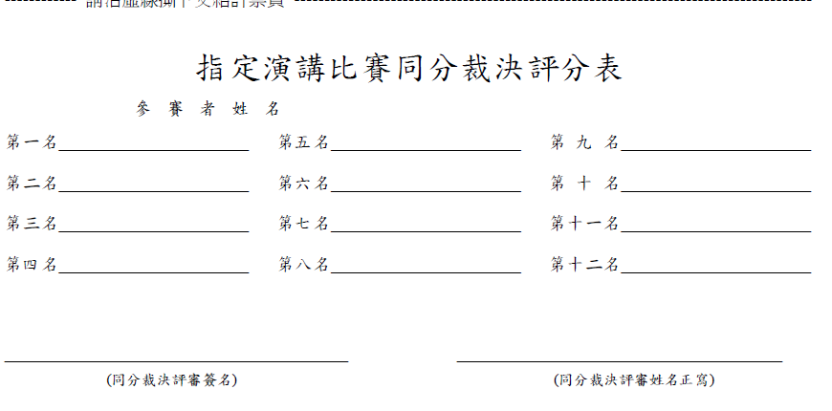
Tie Breaking Judge
Hand ballot directly to the Chief Judge
Notes:
同分裁判的評分表只有在全部裁判提名的前三名,總分加總後有同分的情況下,才會列入參考. 同分裁判要列出所有參賽者的名次排列.總分同分的參賽者的得獎順序由同分裁判的列排優先次序為基準.
The Tie Breaking Judge ranks all contestants. The contestant order is used when there are same scores after adding up the top 3 place winners and their points. Whoever is ranked ahead on the tie breaking budge’s ballot, he/she will be considered for that place.

Slide 26
Chief Judge p.15
Look for voting judges, counters, timers, and (tie-breaking judge)
3 counters
Judges briefing for all
Review judge’s Guide
Speaking area
Sit close to contest area
Collect timing sheet, tie-breaking judge’s ballot
Resolve protests
Monitor counting process, count 2x
Provide placement of winners to contest chair

Slide 27
Protest – by Judges & Contestants
Eligibility
Membership
Overtime
Contestants are ineligible according to contest rule book
Originality
25% or less maybe devoted to quoting, paraphrasing, or referencing another person’s content,
must be identified in the speech
Protest -> Chief Judge & Contest Chair
Contestant can respond
Judges vote to disqualify the contestant

Slide 28
Results are final after Announcement
Announcement of contest winners is final unless the list of winners is announced incorrectly, in which case the chief judge, ballot counters, or timers are permitted to immediately interrupt

Slide 29
The Job of a Judge
is NOT to Evaluate a contestant
An Evaluator -
- appraises a speech
- measures performance against a specified goal
- recommends ways to improve
A Judge – ranks contestants according to the criteria
Notes:
裁判的工作並不是當講評員. 講評的用意是要
點出演講的優點,
根據事前擬定的明確目標 用來比較演講的效果
提出進步的建議

Slide 30
Judges should remain anonymous
When Practical
Refrain from public criticism of the contest
Only reveal the role of a judge, scores, and ranking in accordance with speech contest rules.

Slide 33
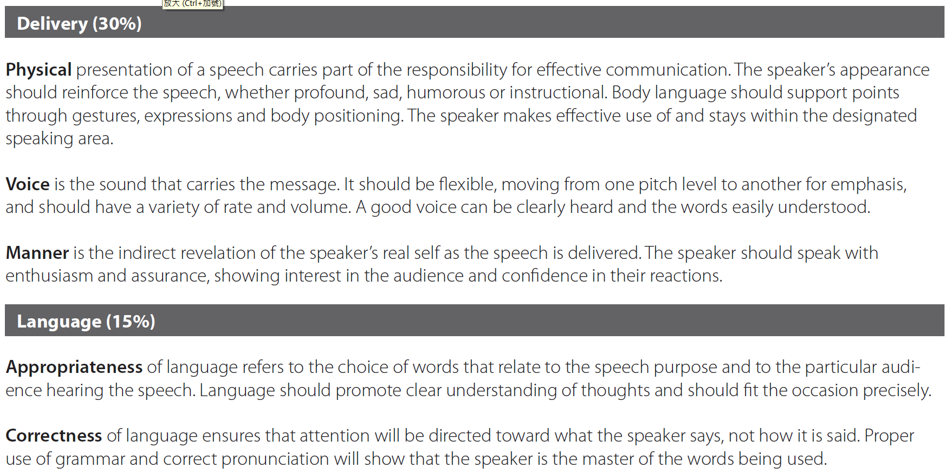

Slide 36
Barriers to Objectivity
1st or Last Speaker is Best
Let’s help the underdog
Halo Effect
Reverse Halo Effect
2nd Time Around
Give Someone Else a Chance
Club Norms
Prejudice & Personal Preference
Unfamiliar with Judging Forms

Slide 39
