Slide 1
Useful Training Tips
Division H 21 Oct 2014 Douglas Huang, ACS, ALS

Slide 2
Toastmasters International
What is our objective today ?
“ability to coordinate, prepare, and deliver a quality Speech Contest”

Slide 3
Preparations
Resources
During Contest

Slide 4
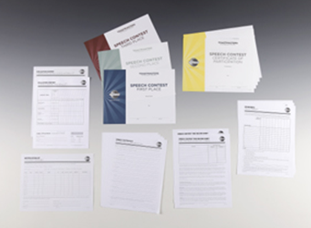
Resources
Certificates
Participants
Helpers
Contest Chair
Chief Judge
Judges
Contest Sheets
Winners
Timer’s Sheet
Tally Vote
Judge Ballads
…
Judges
Invitations
appreciations
Venue
Bookings
Equipment’s
…

Slide 5
During Contest
House Keeping’s
Mobile Phones
Microphone
Projector
Stage
Timer Cards
Stop watch
Extra Pens
Snack / drinks
SAA
Speakers
Drawing order in advanced
Seated in one area
Evaluation – have paper
Judges
Ballad sheets
Discreet
Ballad collections

Slide 6
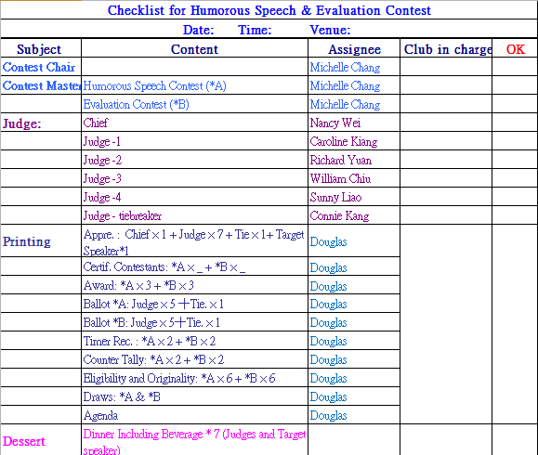
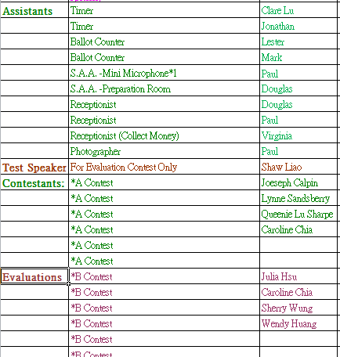
Checklist

Slide 7
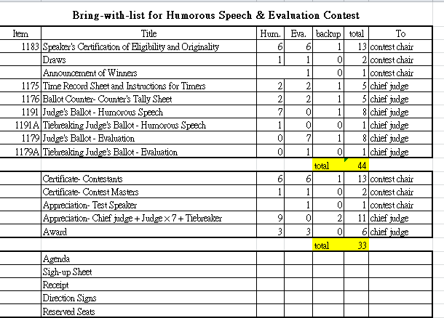
Checklist

Slide 8
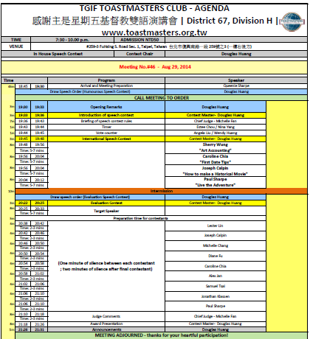
Agenda

Slide 9
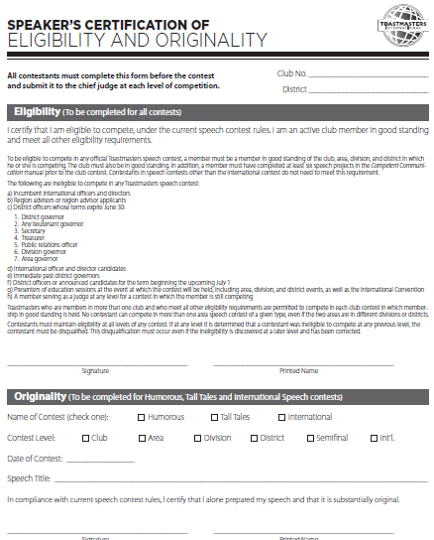
Speaker’s Eligibility

Slide 10
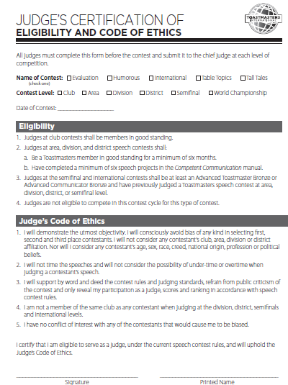
Judge’s Eligibility

Slide 11
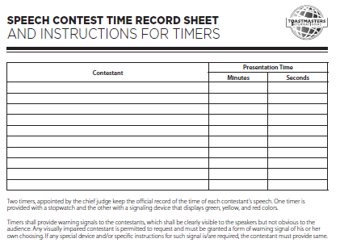
Timer’s Sheet

Slide 12
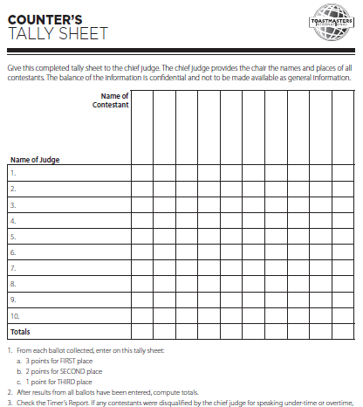
Vote Counter

Slide 13
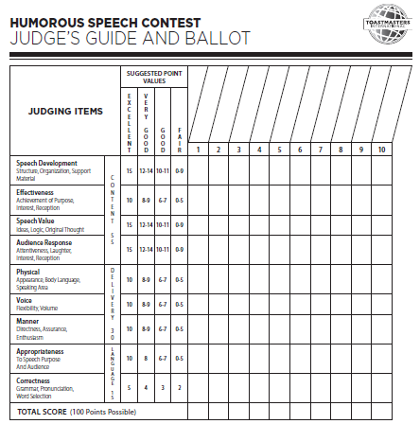
Judge Ballot (A)

Slide 14
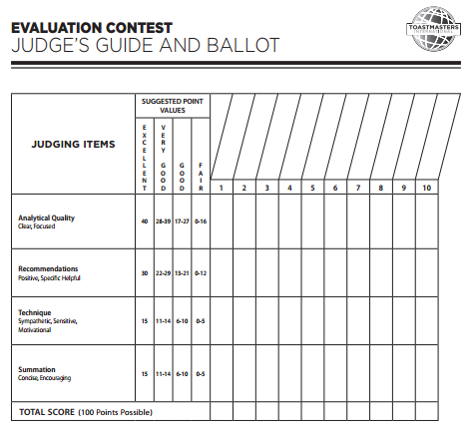
Judge Ballot (B)

Slide 16
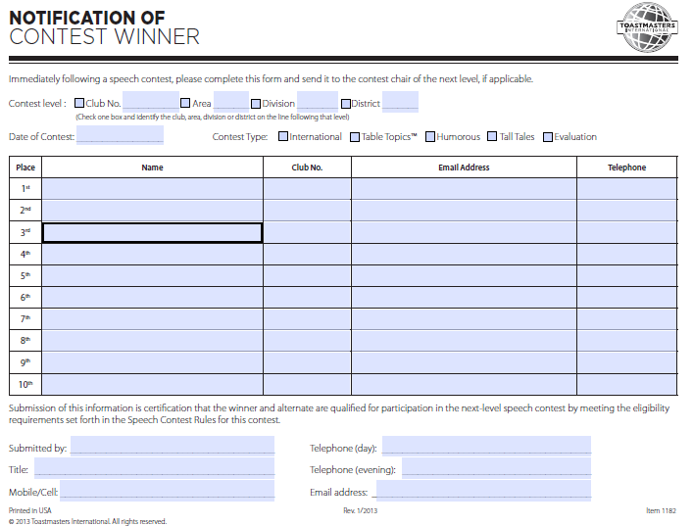
Winner Notifications

Slide 18
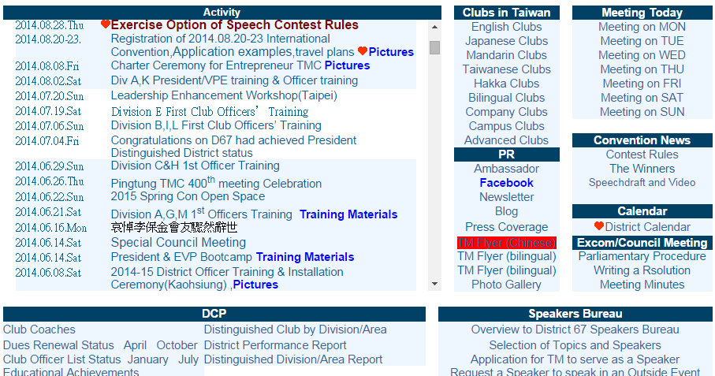
D67 Website

