Slide 1
Quality Meeting Conduction 優質的會議
Presented by Joe Chang (張欽豐)
C3 Assist Governor of Education

Slide 2
國際非營利組織比較
組織 | 創會 | 會員(萬) | 例會/月 | 類型
獅子會 | 1917 | 130 | 4次 | 公益及社區服務
同濟會 | 1915 | 60
扶輪社 | 1905 | 122
演講會 | 1924 | 31 | 2次 | 學習型 21.4人/Club

Slide 3
祝 賀辭 (Toast)
“Toastmaster" was a popular term that referred to a person who gave toasts at banquets (宴會) and other occasions
人
時間
場合
語言

Slide 4
例會的重要性 Importance of Regular Meeting
Non-Member
非會員
Regular Meeting
No
Worthy
值得
Officers
Training
Conference
Contests
Other Activities
Yes
Toastmasters
演講會會員

Slide 5
演講社會員 (Who Joins Toastmasters)
52%
48%
Male
Female

Slide 6
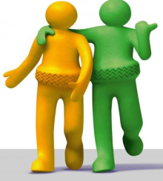
Who Joins Toastmasters
82%
18%
college degree
or Higher
Others

Slide 7
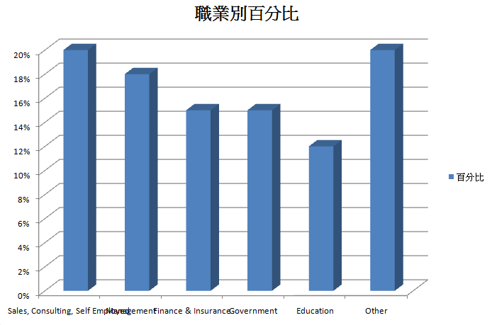
Who Joins Toastmasters

Slide 8
What industries employ Toastmasters? (http://sixminutes.dlugan.com/toastmasters-who-what-when-where-why-how/)
Engagement
20% Sales, Consulting, Self Employed
18% Management
15% Finance & Insurance
15% Government
12% Education
20% Other
Age Profile
69% of members are between the ages of 35 and 49

Slide 9
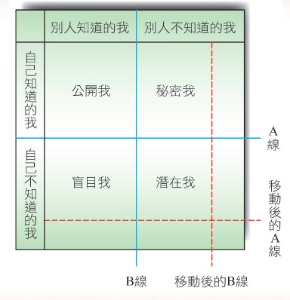
知己知彼百戰百勝
周哈里窗

Slide 11
Reasons to Join Toastmasters 自己知道的我
Become a Better Speaker
Become a Better Listener
Develop Stronger Leadership Skills
Improve Job Interview Skills
Help You Think on Your Feet
Expand Your Network

Slide 13
Why Toastmasters Move Out
Challenging No Longer Exists
Same Feedback While Delivering Speech.
Terrible Speech But Great Feedback.
Too much Focus on Skills
Too little emphasis on content of speech
Cannot Fit the Reality
Job Change or Moving

Slide 14
會議準備

Slide 15
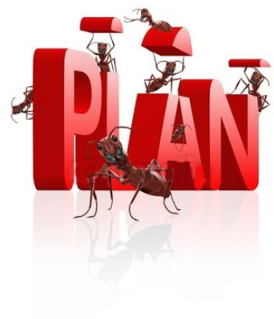
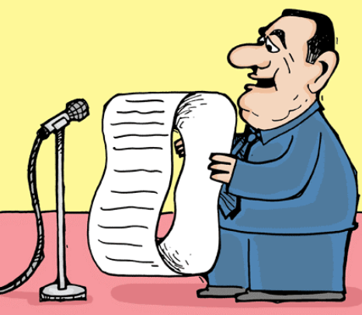
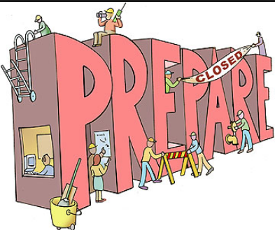

Slide 16
Minimum Assignments For Quality Meeting Conduction
Role | No. Of Assignment
 | Original | Compromise | Compact
SAA | 1 | 1 | 1
TME | 1
Helpers (Timer/Ah Counter/Vote Counter) | 3 | 1 | 1
Table Topic Session Master | 1 | 1 | 1
Prepared Speech | 3 | 3 | 2
Variety Session Master | 1 | 1 | 1
General Evaluator | 1 | 1 | 1
IE | 3 | 3 | 2
Language Evaluator | 1 | 1 | 1
Sub-Total | 15 | 12 | 10
Minimum Attendant Members | 10~11 | 8~9 | 6~7

Slide 17
會議進行

Slide 18
例會環境
應該 (Must)
友善
有趣
值得學習
妥善準備會議佈置
Must Not
凌亂無組織
無人招呼或引導 Guest

Slide 19
議程順序
Regular Meeting
Greeting & Introduction
The Joke ／ Variety Session
The Prepared Speech
The Table Topic Session
The Evaluation Session

Slide 20
Meeting Theme
應該 (Must)
大家熟悉、關心或有興趣的主題
易懂、容易發揮
避免 (Must Not)
Political, Sex Relevant, Religious Issues

Slide 21
會議主題的功能 Functions of Meeting Themes
議程轉換 (Transition)
介紹 (Introduction)
桌邊話題 (Table Topics)
連結每日一詞，貫穿會議Word of the day (provide meeting theme to grammarian for word of the day)

Slide 22
每日一詞 (Words of the Day)
增加字彙 (Enrich vocabularies)
由語言評論員提供
每日一詞- 書寫於會議室前側：意義、正確發音 及 用法
連結 會議主題，鼓勵大家使用

Slide 23
Example of Word of the Day
Word of the Day : Device /dɪˈvʌɪs/
noun
A thing made or adapted for a particular purpose, especially a piece of mechanical or electronic equipment
…
Example
Such articles include electronic devices, dust handling equipment and notebook computer enclosures.
…

Slide 24
TME
應該 (Must)
介紹 Toastmasters 的 Values 及體驗
節目介紹
Helpers / Session Masters / Speakers 引言及介紹
Sessions 間的引導及轉折
避免 (Must Not)
臨時 Interview
搶 參予者的光彩
時間失控

Slide 25
The Joke／Variety Session
The Session master arouses to speak joke or play games, brings relaxing atmosphere for the meeting. Members and guests all take part in.
笑話或遊戲(Joke／Variety Session)：由笑話或遊戲主持人帶動講笑話或是遊戲，為例會先帶來一些輕鬆的氣氛，會員或來賓皆可參加。

Slide 26
Table Topic Session Master
應該 (Must)
Meeting Theme Relevant
Question: Clear / Short / Easy to Reply
Most Time Reserved for Speakers
避免 (Must Not)
Question: too much assumption
Disturb or Embarrass Assigned Speaker
No Yes/No Question

Slide 27
Evaluation
應該 (Must)
依照 Project 的 Objectives 評論
評論 至少有一點關於 演講內容的價值
已完成projects 技巧可綜合於評論
避免 (Must Not)
避免落於俗套
除了 示範比對, 不要重複 Speaker 講詞
評論- 勿將尚未做 projects 的技巧

Slide 28
General Evaluator
應該 (Must)
時間掌控
Session Masters 的表現
會議的流程
Evaluator 表現
避免 (Must Not)
形式化

Slide 29
Language Evaluation
應該 (Must)
好的用詞與文句
文法
新的用詞
文法、用辭、拼音 錯誤指正
口語用辭 與 文章用辭的差別

Slide 30
對策

Slide 31
提升能力 傳承制度 (Mentoring System)
功能
俱樂部文化傳承
熟悉 會議規則
瞭解 會議角色的作為
演講價值與技巧
如何建立傳承制度
“一對一”
“多對多”
場合
形式

Slide 32
提升價值
會議整合
演講內容
評論中肯
事前準備
會員參予

