Slide 1
N
Officer Training 分會幹部培訓
Club Success Plan for DCP 邁向傑出分會的「分會成功計畫」
Sterling Hsiao, DTM , Former Division Governor
Eddy Lin, ACB,CL , Area C4 Governor
2015/01/31

Slide 2
傑出分會計劃和成功分會計劃
如何成為傑出分會

Slide 3
Distinguished Club Program
傑出分會計劃
Education 教育
Training 培訓
2 CC
2 more CC
1 ACB, ACS or ACG
1 more ACB, ACS or ACG
1 CL, ALB, ALS or DTM
1 more CL, ALB, ALS or DTM
≥ 4 officers trained
Administration 行政
Dues on time & one officer list submitted on time
Membership 會員
4 new members
4 new members

Slide 4
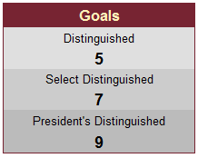
Distinguished Club Program
傑出分會計劃
20 members or
A net growth of ≥ 5 new members

Slide 5
DCP: Education Award
傑出分會計劃：教育獎
2 CC
2 more CC
Your club receives credit for only one type of education award per member per year 同一個教育獎項，每個會員每年只能為某個分會貢獻1分
1 ACB, ACS or ACG
1 more ACB, ACS or ACG
1 CL, ALB, ALS or DTM
1 more CL, ALB, ALS or DTM
Credit for an award may be given to only one club 某一教育獎項的分數，只能給一個分會

Slide 6
DCP: Membership
傑出分會計劃：會員成長
4 new members
4 new members
Who are counted as “New members”? 誰算新會員？
New, dual & reinstated members
Who are not counted as “New members”? 誰不算新會員？
Transfer & charter members

Slide 7
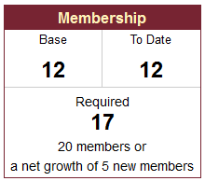
DCP: Membership
傑出分會計劃：會員成長
20 members or
A net growth of ≥ 5 new members
Jul 1, 2014
Jun 30, 2015
Net growth of 5

Slide 8
DCP: Training
傑出分會計劃：幹部培訓
≥ 4 officers trained
Credit is not given for non-officers attending in place of elected officers 非幹部會員代替幹部參加幹部培訓，拿不到點數
Officers must be trained in live training session (officers who view a video of training does not count) 幹部必需親自出席 (觀看錄影培訓不算)

Slide 9
DCP: Administration
傑出分會計劃：行政
Dues on time & One officer list submitted on time
Dues deadline 繳費期限
Sep 30, 2014 (Oct 10)
Mar 31, 2015 (Apr 10)
≥ 8 members
≥ 3 renewing
Officer list deadline
幹部名單期限
Jun 30, 2014
Dec 31, 2014
“Pay it forward”
前人種樹後人乘涼
Notes:
Deadline
8 at least

Slide 10
Club Success Plan 分會成功計劃
Basics 基本：
Review online reports regularly 定期查看世界總會報告
Meet regularly to evaluate progress 幹部定期開會評估進度
How often is your officers’ meeting? 你們分會多少開一次幹部會議?

Slide 11
Club Success Plan 分會成功計劃
Set specific goals 設立目標： attainable and inspiring 可到達也有鼓舞性
Establish strategies to achieve the goals 建立到達目標的策略
Develop a framework to help carry out the plan and produce results 形成一個執行架構來幫助執行這個計劃並產出成果

Slide 12
Club Success Plan 分會成功計劃
20 members or
A net growth of ≥ 5 new members
Qualifying Requirement：
Goals to Achieve:

Slide 13
Club Success Plan 分會成功計劃
Action Plan: Overall
Situation Analysis ：
who have, who will have, when will have, obstacles
Moment of Truth
Action Plan :
how can the Club help？
how can the Area/Division help?
how can the District help

Slide 14
Club Success Plan 分會成功計劃
Action Plan: Education
Speech-a-thon 演講馬拉松
Support other clubs as a guest speaker 到其他分會支援演講

Slide 15
Club Success Plan 分會成功計劃
Action Plan: Membership
Membership campaign/competition 分會會員成長活動/比賽
District Membership incentive 總會會員成長獎勵計畫

Slide 16
Club Success Plan 分會成功計劃
Action Plan: Membership
Membership Building Programs for Clubs:
Program | Dates | Requirement
Smedley Award | Aug 1 – Sep 30 | 5 new, dual, or reinstated members
Talk Up Toastmasters | Feb 1 – Mar 31
Beat the Clock | May 1 – Jun 30

Slide 17
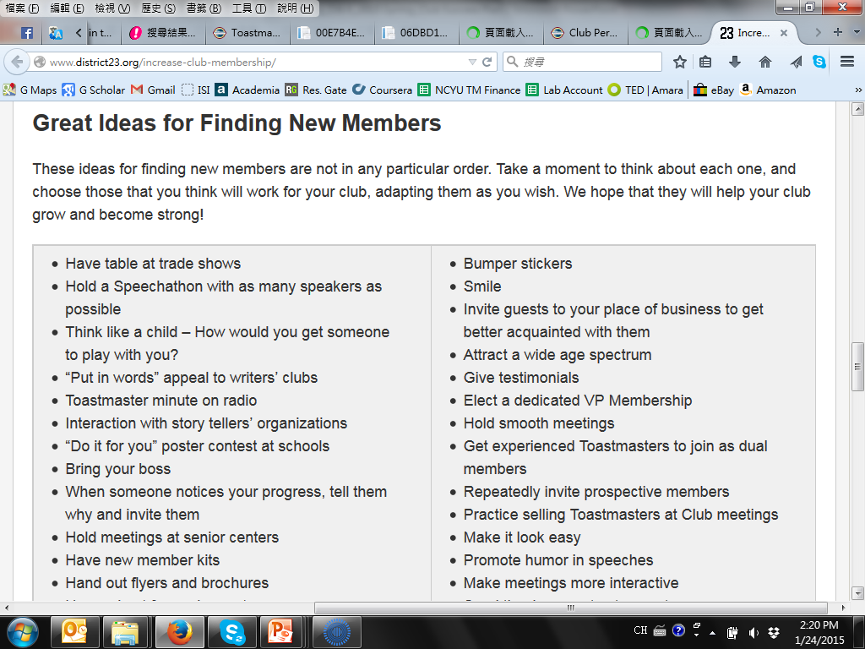

Slide 18
Club Leadership Handbook 分會領導手冊： English: http://www.toastmasters.org/clh 繁體中文: http://www.toastmasters.org/CT1310PDF
Distinguished Club Program 傑出分會計劃：
English: http://www.toastmasters.org/EN-1111
繁體中文: http://www.toastmasters.org/CT-1111

Slide 19
Member Achievement Record 會員成就記錄
The Successful Club Series 成功分會系列
Membership Building Programs for Clubs

Slide 20
N
Pop Quiz
Eddy Lin : happy4468@gmail.com

