Slide 1
分會幹部必須了解的 總會網站 [會務後台]
All Club Officers need to know – Club Central –
Peyton Kim 金培琨
Division K Governor K部總監
2013-2014
www.toastmasters.org.tw
Notes:
Welcome to the Toastmasters refreshed brand! Toastmasters International unveiled a new logo, tagline and positioning on Wednesday, August 17, 2011; the first day of International Convention.
The rebrand is a significant step forward in achieving the mission of Toastmasters International. By creating a consistent identity across the globe, we ignite efforts to build membership and increase recognition of the organization. This consistency will inform prospective members, regardless of location, that Toastmasters is the leading organization dedicated to helping them become the speakers and leaders they want to be. While this is not a radical change, the rebrand will take a concerted effort to make the transition across all districts and clubs. In this presentation I’m going to share with you:
An overview of branding.
The reasons why a rebrand was necessary.
The results of the research conducted to identify Toastmasters’ in the market place and in the minds of members and prospective members.
The Toastmasters brand position and visual system.
Club’s role in the brand refresh.

Slide 2
訓練大綱
申報[新會員基本資料]
繳付[會員會費]
查詢/申報[分會幹部名單]
申報[會員教育成就資料]
查詢[分會會員名冊資料]
指派[分會委託人]
查詢[分會傑出分會DCP成績]
www.toastmasters.org
Notes:
Before we get into specific details about the Toastmasters positioning, lets discuss what branding involves. Most of the time when people hear the word branding they think of logos. Although a logo is a part of the brand it is only a part of an organizations brand. A brand is the essence of an organization or a product. A brand encompasses many things:
Color
Images
Logo
Personality (the words we use, the tone we set)
It’s who we are and what benefit we offer, personified
So what is the definition of a brand?

Slide 3
分會幹部有哪些?
www.toastmasters.org
Notes:
So now that we have seen the new look of Toastmasters – what is a club’s role in the Toastmasters brand refresh?

Slide 4
分會幹部
會長 Club President
教育副會長 Club VP Education (VPE)
會員副會長 Club VP Membership(VPM)
公關長 Club VP PR (VPPR)
秘書 Club Secretary
財務長 Club Treasurer
事務長 Club Sergeant at Arms
www.toastmasters.org
Notes:
Before we get into specific details about the Toastmasters positioning, lets discuss what branding involves. Most of the time when people hear the word branding they think of logos. Although a logo is a part of the brand it is only a part of an organizations brand. A brand is the essence of an organization or a product. A brand encompasses many things:
Color
Images
Logo
Personality (the words we use, the tone we set)
It’s who we are and what benefit we offer, personified
So what is the definition of a brand?

Slide 5
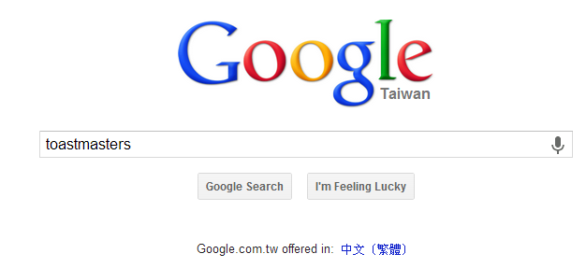
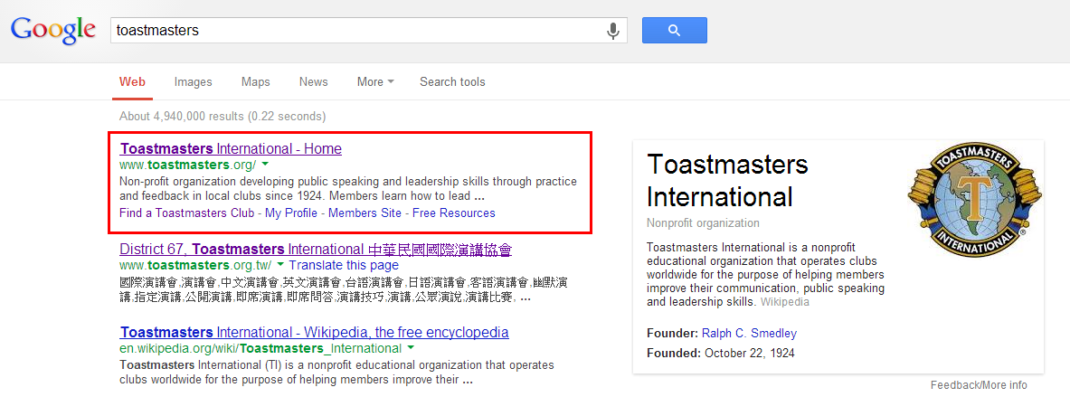
Google 搜尋引擎
輸入關鍵字 toastmasters
www.toastmasters.org
Notes:
Before we get into specific details about the Toastmasters positioning, lets discuss what branding involves. Most of the time when people hear the word branding they think of logos. Although a logo is a part of the brand it is only a part of an organizations brand. A brand is the essence of an organization or a product. A brand encompasses many things:
Color
Images
Logo
Personality (the words we use, the tone we set)
It’s who we are and what benefit we offer, personified
So what is the definition of a brand?

Slide 6
總會網站 http://www.toastmasters.org
點選
LOGIN 登入
www.toastmasters.org
Notes:
Before we get into specific details about the Toastmasters positioning, lets discuss what branding involves. Most of the time when people hear the word branding they think of logos. Although a logo is a part of the brand it is only a part of an organizations brand. A brand is the essence of an organization or a product. A brand encompasses many things:
Color
Images
Logo
Personality (the words we use, the tone we set)
It’s who we are and what benefit we offer, personified
So what is the definition of a brand?

Slide 7
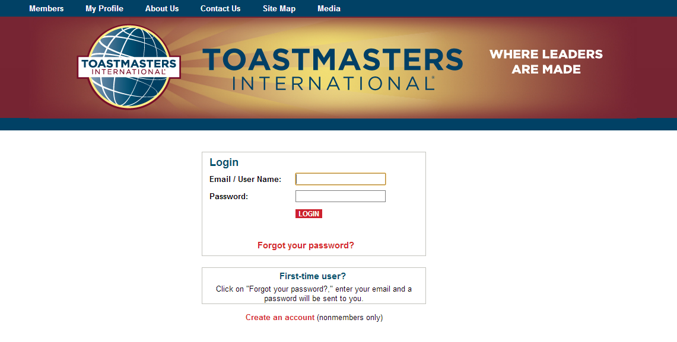
登入畫面
WHAT IS A BRAND?
http://www.toastmasters.org > Login
www.toastmasters.org
Notes:
Before we get into specific details about the Toastmasters positioning, lets discuss what branding involves. Most of the time when people hear the word branding they think of logos. Although a logo is a part of the brand it is only a part of an organizations brand. A brand is the essence of an organization or a product. A brand encompasses many things:
Color
Images
Logo
Personality (the words we use, the tone we set)
It’s who we are and what benefit we offer, personified
So what is the definition of a brand?

Slide 8
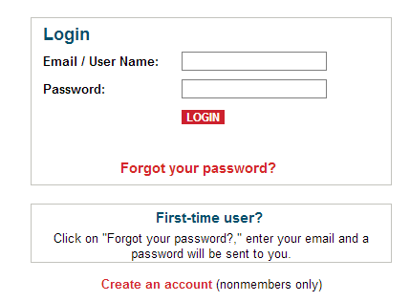
登入系統 (輸入帳號及密碼)
當初登錄會員時使用的email (roster 中的email address)
登入
忘記密碼
www.toastmasters.org
Notes:
A brand is an exclusive and desirable idea embodied in products, places, services, people and experiences.
When we say exclusive and desirable idea – it truly means that the brand of an organization is exclusive and people have a desire to attain that brand. In Toastmasters we all know that the organization is unique – however it’s not easy to describe. We need a story to tell about this organization, and the brand refresh gives us this story. Think about the people we are trying to engage in Toastmasters – they vary in many different ways. Having one consistent position will help us to adapt our messaging to these varied audiences.
You can also see in this definition that a brand is embodied in products, places, services, people and experiences. Sometimes when we think of branding we instantly think of a tangible product however it involves much more. Think about Hollywood, Disney World, consulting businesses, your favorite actor or actress – these all have very distinct brands that are exclusive to what they provide.
Now the second half of the definition is: a great brand has the power to change perception, influence preference and command loyalty.
All great brands have changed people’s perceptions – they alter how people think of them. Think of Starbucks. Do you think they have the best tasting cup of coffee? Not necessarily, but we’re buying the experience as much as we are the cup of coffee.
If people prefer us, they join us. People interested in self-improvement won’t just go to any speaking and leadership organization; they’ll go to Toastmasters.
If we all work hard to unite the Toastmasters brand, our organization will position itself in a way where it can truly achieve its mission.

Slide 9
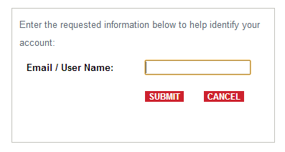
忘記密碼?
可輸入會員編號或註冊會員時登錄的電子信箱,
若資料輸入正確，稍後即可收到總部寄來的
『重設密碼』郵件
www.toastmasters.org
Notes:
Toastmasters was founded 87 years ago. In that time, clubs and districts received little information on how to visually and verbally communicate the Toastmasters brand. As a result, over the years, Toastmasters clubs, districts and regions have increasingly distributed conference brochures, meeting materials and other communication with unique messaging and designs that were intended to display their individuality.
By early 2008, we recognized that this customization had evolved to the point where the Toastmasters brand was suffering. And while the Executive Committee determined that a true evaluation of the brand was likely necessary, a temporary text emblem was developed to give leaders an option.
By early 2009, it became clear that the organization needed to not only regain control of the brand, but evaluate how the brand was perceived.
Branding agencies were researched and interviewed. In November 2009, a branding agency was selected to help us conduct research. Innovation Protocol not only specializes in non-profit brand development, but many of its employees are current or former Toastmasters.
Our agency partner spent 4 months researching Toastmasters.
They talked with members, district leaders, board members and potential members
They reviewed our materials
They attended conferences, club meetings and club leader training
They researched the competition
Out of this research, came many significant challenges that face our organization.
One of these challenges is perception control.

Slide 10
忘記密碼郵件範例
信件內容中會有新的密碼(亂數產生)
Your new password is. $a+-%VvC
可使用 複製 Ctrl+C ，回到登入畫面將密碼貼上 Ctrl+V，即可成功登入
www.toastmasters.org
Notes:
Toastmasters was founded 87 years ago. In that time, clubs and districts received little information on how to visually and verbally communicate the Toastmasters brand. As a result, over the years, Toastmasters clubs, districts and regions have increasingly distributed conference brochures, meeting materials and other communication with unique messaging and designs that were intended to display their individuality.
By early 2008, we recognized that this customization had evolved to the point where the Toastmasters brand was suffering. And while the Executive Committee determined that a true evaluation of the brand was likely necessary, a temporary text emblem was developed to give leaders an option.
By early 2009, it became clear that the organization needed to not only regain control of the brand, but evaluate how the brand was perceived.
Branding agencies were researched and interviewed. In November 2009, a branding agency was selected to help us conduct research. Innovation Protocol not only specializes in non-profit brand development, but many of its employees are current or former Toastmasters.
Our agency partner spent 4 months researching Toastmasters.
They talked with members, district leaders, board members and potential members
They reviewed our materials
They attended conferences, club meetings and club leader training
They researched the competition
Out of this research, came many significant challenges that face our organization.
One of these challenges is perception control.

Slide 11
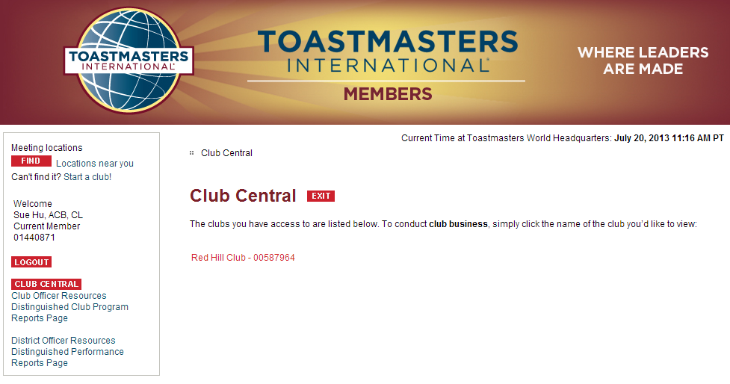
首先點入所屬[分會]
如: Red Hill Club - 00587964
www.toastmasters.org
Notes:
So now that we have seen the new look of Toastmasters – what is a club’s role in the Toastmasters brand refresh?

Slide 12
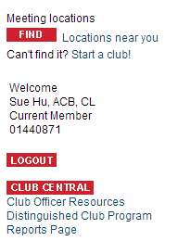
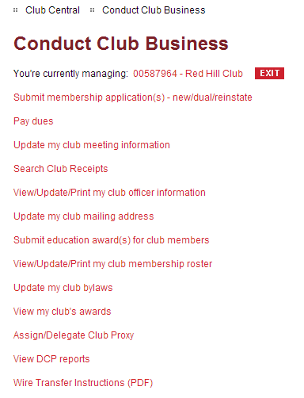
會務後台
只有分會幹部可執行[會務後台]
才看得到[Club Central]
www.toastmasters.org
Notes:
Before we get into specific details about the Toastmasters positioning, lets discuss what branding involves. Most of the time when people hear the word branding they think of logos. Although a logo is a part of the brand it is only a part of an organizations brand. A brand is the essence of an organization or a product. A brand encompasses many things:
Color
Images
Logo
Personality (the words we use, the tone we set)
It’s who we are and what benefit we offer, personified
So what is the definition of a brand?

Slide 13
Submit membership application(s) - new/dual/reinstate 申報[新會員基本資料]
Pay dues 繳交[會員會費]
Update my club meeting information 更新分會資訊 (地點，時間…)
Search Club Receipts
View/Update/Print my club officer information 查詢/申報[分會幹部名單]
Update my club mailing address 更新分會聯絡email電子郵件
Submit education award(s) for club members 申報[會員教育成就資料]
View/Update/Print my club membership roster 查詢[分會會員名冊資料]
Update my club bylaws
View my club's awards
Assign/Delegate Club Proxy 指派[分會委託人]
View DCP reports 查詢[分會傑出分會DCP成績]
www.toastmasters.org
Notes:
So now that we have seen the new look of Toastmasters – what is a club’s role in the Toastmasters brand refresh?

Slide 14
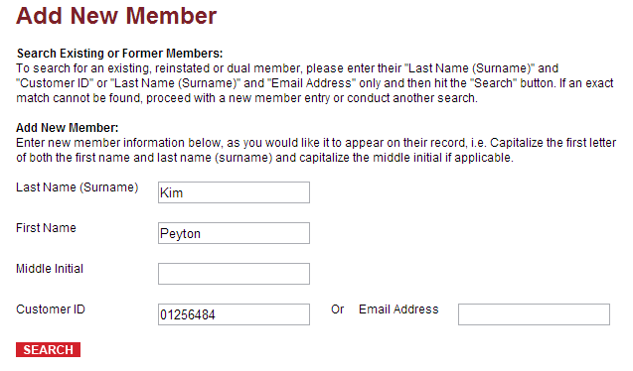
申報[新會員基本資料]
姓
新會員填此資料
名
使用時機:
雙重會員(Dual)
恢復會籍舊會員(Reinstate)
會員編號
www.toastmasters.org
Notes:
Before we get into specific details about the Toastmasters positioning, lets discuss what branding involves. Most of the time when people hear the word branding they think of logos. Although a logo is a part of the brand it is only a part of an organizations brand. A brand is the essence of an organization or a product. A brand encompasses many things:
Color
Images
Logo
Personality (the words we use, the tone we set)
It’s who we are and what benefit we offer, personified
So what is the definition of a brand?

Slide 15
申報基本資料[雙重會員(Dual)/恢復會籍舊會員(Reinstate)]
若現有資料庫找不到名單，點選此按鈕來新增會員
www.toastmasters.org
Notes:
Before we get into specific details about the Toastmasters positioning, lets discuss what branding involves. Most of the time when people hear the word branding they think of logos. Although a logo is a part of the brand it is only a part of an organizations brand. A brand is the essence of an organization or a product. A brand encompasses many things:
Color
Images
Logo
Personality (the words we use, the tone we set)
It’s who we are and what benefit we offer, personified
So what is the definition of a brand?

Slide 16
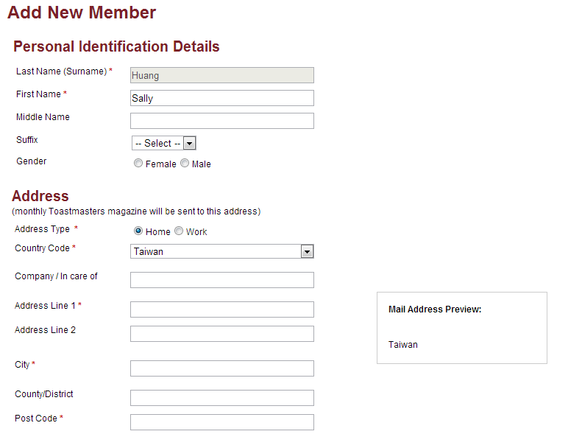
申報基本資料[新會員]
紅色*為必填欄位
雜誌寄送地址,請參考中華郵政
中文地址英譯
http://www.post.gov.tw/post/internet/f_searchzone/index.jsp?ID=190103
www.toastmasters.org
Notes:
Before we get into specific details about the Toastmasters positioning, lets discuss what branding involves. Most of the time when people hear the word branding they think of logos. Although a logo is a part of the brand it is only a part of an organizations brand. A brand is the essence of an organization or a product. A brand encompasses many things:
Color
Images
Logo
Personality (the words we use, the tone we set)
It’s who we are and what benefit we offer, personified
So what is the definition of a brand?

Slide 17
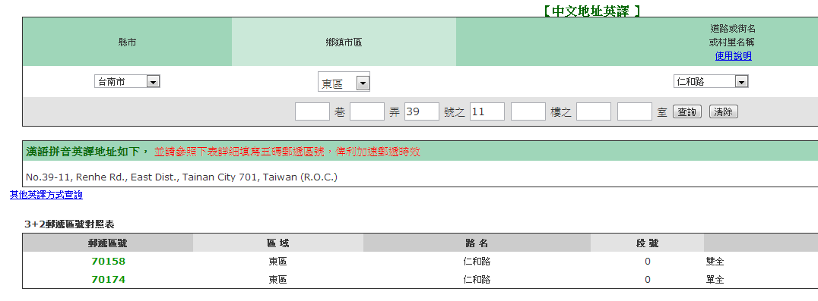
中華郵政-中文地址英譯
網址:
http://www.post.gov.tw/post/internet/f_searchzone/index.jsp?ID=190103
www.toastmasters.org
Notes:
Before we get into specific details about the Toastmasters positioning, lets discuss what branding involves. Most of the time when people hear the word branding they think of logos. Although a logo is a part of the brand it is only a part of an organizations brand. A brand is the essence of an organization or a product. A brand encompasses many things:
Color
Images
Logo
Personality (the words we use, the tone we set)
It’s who we are and what benefit we offer, personified
So what is the definition of a brand?

Slide 18
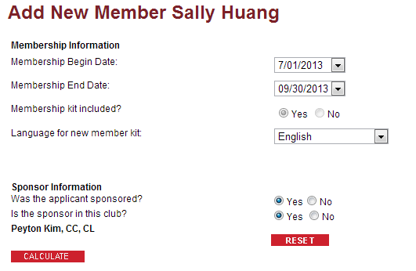
填寫會籍資料
新會員購買CC手冊
選擇:英文版 English
繁體中文版 Chinese Traditional
別忘了填報:
推荐的會員姓名
www.toastmasters.org
Notes:
Before we get into specific details about the Toastmasters positioning, lets discuss what branding involves. Most of the time when people hear the word branding they think of logos. Although a logo is a part of the brand it is only a part of an organizations brand. A brand is the essence of an organization or a product. A brand encompasses many things:
Color
Images
Logo
Personality (the words we use, the tone we set)
It’s who we are and what benefit we offer, personified
So what is the definition of a brand?

Slide 19
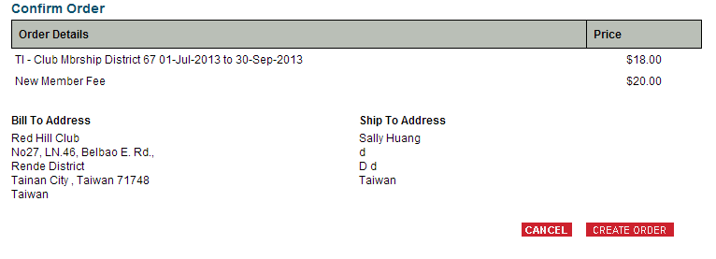
計算會費
雙重會員(Dual)
恢復會籍舊會員(Reinstate)
可不買手冊,省$20美金
www.toastmasters.org
Notes:
Before we get into specific details about the Toastmasters positioning, lets discuss what branding involves. Most of the time when people hear the word branding they think of logos. Although a logo is a part of the brand it is only a part of an organizations brand. A brand is the essence of an organization or a product. A brand encompasses many things:
Color
Images
Logo
Personality (the words we use, the tone we set)
It’s who we are and what benefit we offer, personified
So what is the definition of a brand?

Slide 20
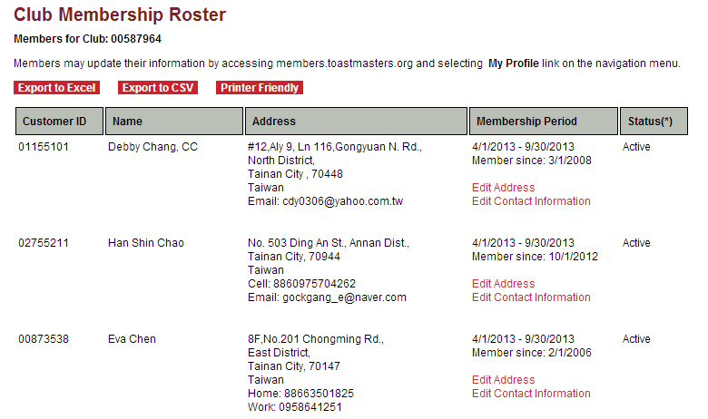
查詢[分會會員名冊資料]
可以匯出為CSV檔
www.toastmasters.org
Notes:
So now that we have seen the new look of Toastmasters – what is a club’s role in the Toastmasters brand refresh?

Slide 21
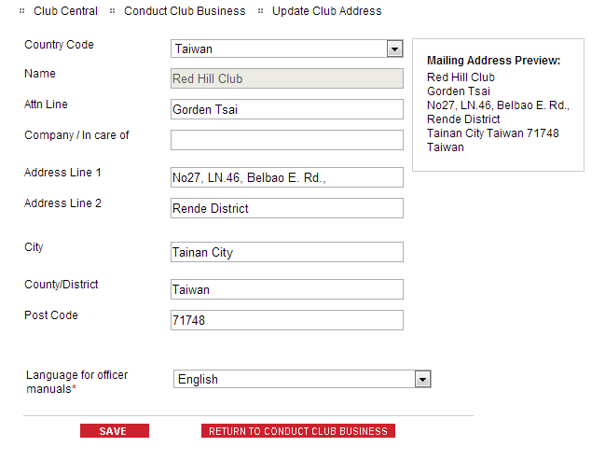
更新分會郵寄資訊(幹部手冊)
www.toastmasters.org
Notes:
So now that we have seen the new look of Toastmasters – what is a club’s role in the Toastmasters brand refresh?

Slide 22
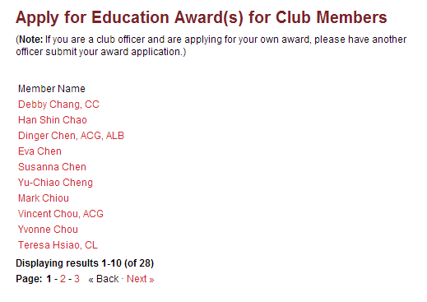
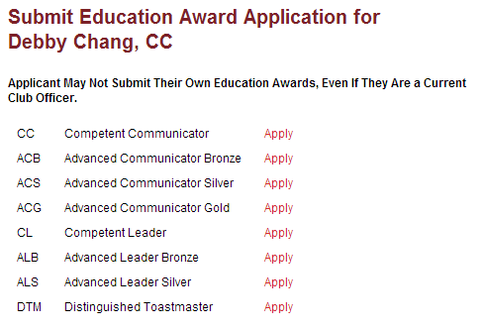
申報[會員教育成就資料] (EVP教育副會長)
1.點選會員名字
2.選擇欲申報成就(CC或CL)
www.toastmasters.org
Notes:
So now that we have seen the new look of Toastmasters – what is a club’s role in the Toastmasters brand refresh?

Slide 23
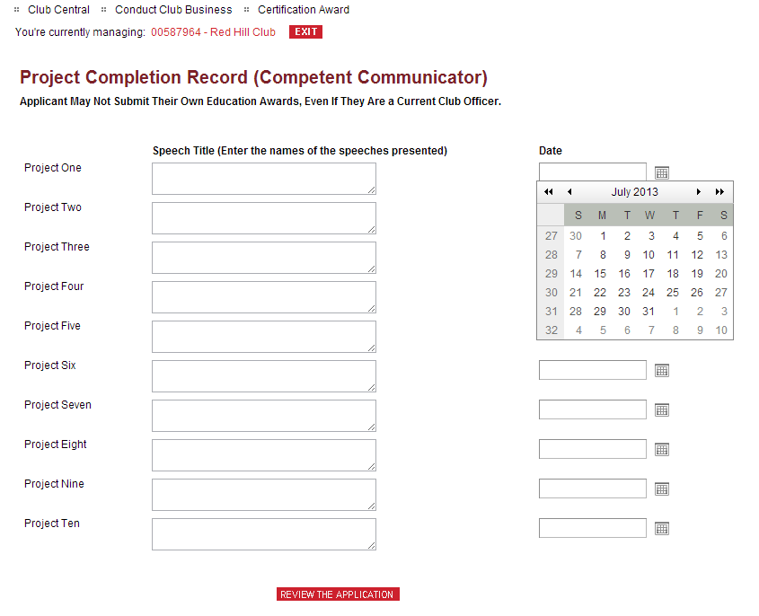
申報[會員教育成就資料,如CC] (EVP教育副會長)
第一講演講日期
第一講演講標題
第十講演講標題
第十講演講日期
申報CC要填寫此10講的『標題』與『實行日期』
並記得選擇兩本免費手冊
www.toastmasters.org
Notes:
So now that we have seen the new look of Toastmasters – what is a club’s role in the Toastmasters brand refresh?

Slide 24
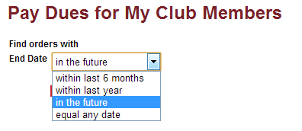
繳付[會員會費] Treasurer財務長
within last 6 months: 補繳過去六個月
within last year: 補繳過去一年
In the future: 繳付當期/下期會費
equal any day: 列出全部[含補繳以前]
www.toastmasters.org
Notes:
Before we get into specific details about the Toastmasters positioning, lets discuss what branding involves. Most of the time when people hear the word branding they think of logos. Although a logo is a part of the brand it is only a part of an organizations brand. A brand is the essence of an organization or a product. A brand encompasses many things:
Color
Images
Logo
Personality (the words we use, the tone we set)
It’s who we are and what benefit we offer, personified
So what is the definition of a brand?

Slide 25
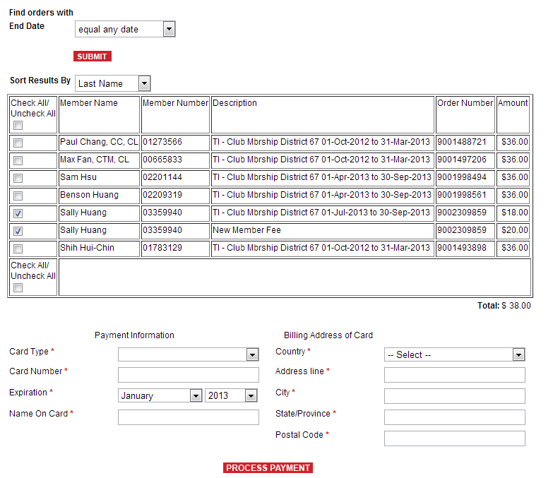
繳費頁面 Treasurer財務長
再確認要繳付:正確的會費期間
使用信用卡付款
信用卡型式
信用卡號碼
有效期限
信用卡姓名
帳單寄送:國家
帳單寄送:地址
帳單寄送:城市
帳單寄送:省/郡
帳單寄送:郵遞區號
www.toastmasters.org
Notes:
So now that we have seen the new look of Toastmasters – what is a club’s role in the Toastmasters brand refresh?

Slide 26
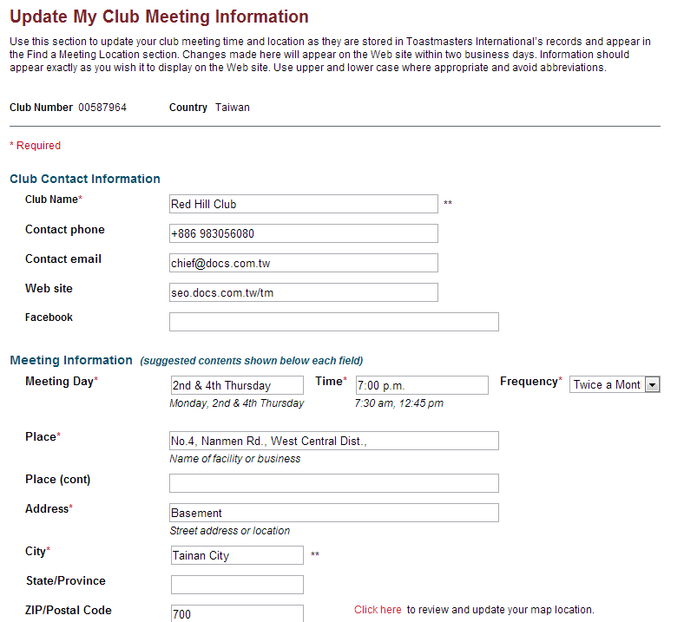
更新分會資訊 (地點，網站,時間…)
網址 (行銷用)
臉書
www.toastmasters.org
Notes:
So now that we have seen the new look of Toastmasters – what is a club’s role in the Toastmasters brand refresh?

Slide 27
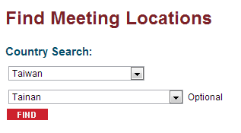
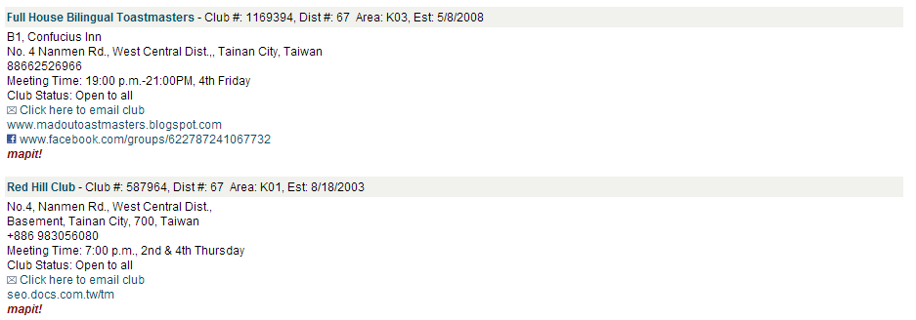
世界總會網站搜尋分會結果範例 (台灣,台南)
Meeting Location Search Results Search Criteria: Taiwan, Tainan, Results: 1 - 7 of 7
www.toastmasters.org
Notes:
So now that we have seen the new look of Toastmasters – what is a club’s role in the Toastmasters brand refresh?

Slide 28
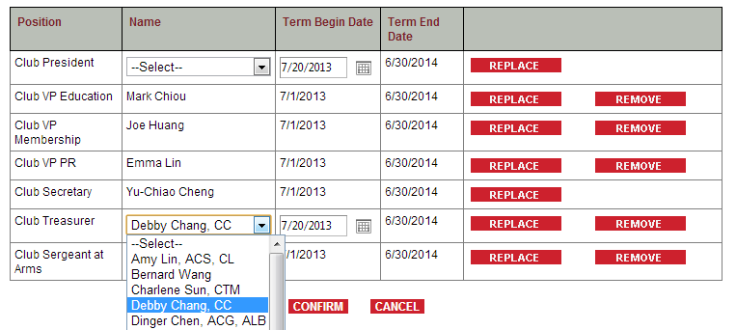
更新 [分會幹部名單] President會長/ Secretary祕書長
點選 ,從下拉式選單中選擇正確的幹部名字，點選
確認,點選 刪除該人選
www.toastmasters.org
Notes:
Before we get into specific details about the Toastmasters positioning, lets discuss what branding involves. Most of the time when people hear the word branding they think of logos. Although a logo is a part of the brand it is only a part of an organizations brand. A brand is the essence of an organization or a product. A brand encompasses many things:
Color
Images
Logo
Personality (the words we use, the tone we set)
It’s who we are and what benefit we offer, personified
So what is the definition of a brand?

Slide 29
更新幹部名單 (需於6月30日前完成)
很重要
www.toastmasters.org
Notes:
So now that we have seen the new look of Toastmasters – what is a club’s role in the Toastmasters brand refresh?

Slide 30
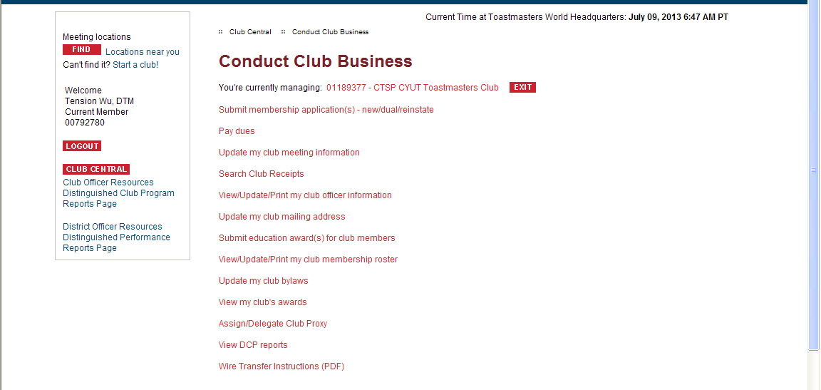
指派[分會委託人]
選擇: 指派[分會委託人]
註: 您必需是分會會長或分會祕書才被授權指派
www.toastmasters.org
Notes:
So now that we have seen the new look of Toastmasters – what is a club’s role in the Toastmasters brand refresh?

Slide 31
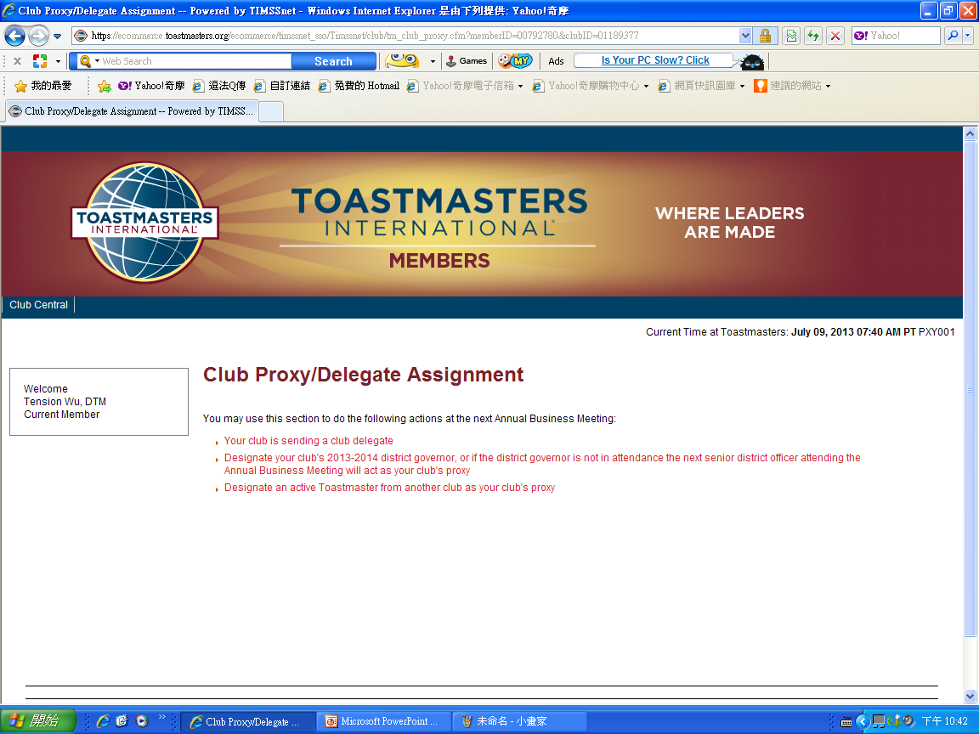
指派[分會委託人]
選擇第2個: 直接指派總會長為[分會委託人]
www.toastmasters.org
Notes:
So now that we have seen the new look of Toastmasters – what is a club’s role in the Toastmasters brand refresh?

Slide 32
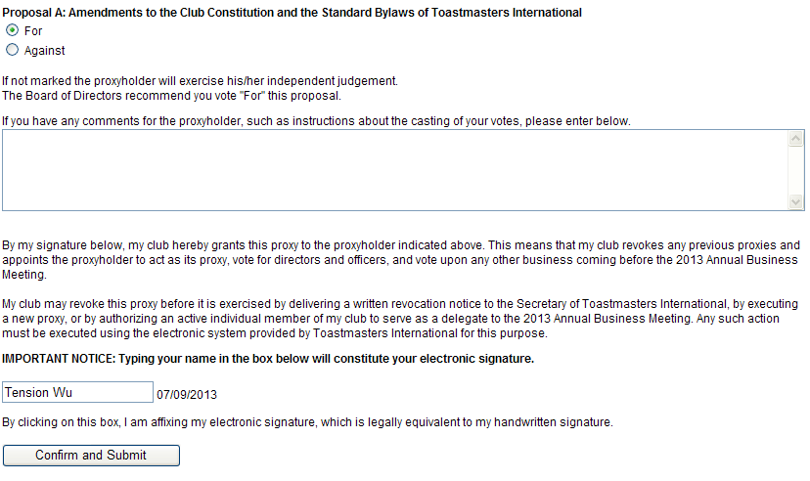
指派[分會委託人]
Peyton Kim
輸入: 您的名字 [中文名或英文名]
確認並送出
www.toastmasters.org
Notes:
So now that we have seen the new look of Toastmasters – what is a club’s role in the Toastmasters brand refresh?

Slide 33
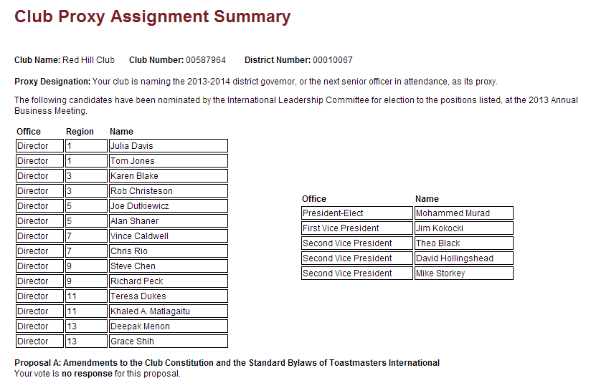
Director Region13 候選人 Grace Shih
看到這一頁，表示指派成功了!
www.toastmasters.org
Notes:
So now that we have seen the new look of Toastmasters – what is a club’s role in the Toastmasters brand refresh?

Slide 34
查詢[分會傑出分會DCP成績]
www.toastmasters.org
Notes:
So now that we have seen the new look of Toastmasters – what is a club’s role in the Toastmasters brand refresh?

Slide 35
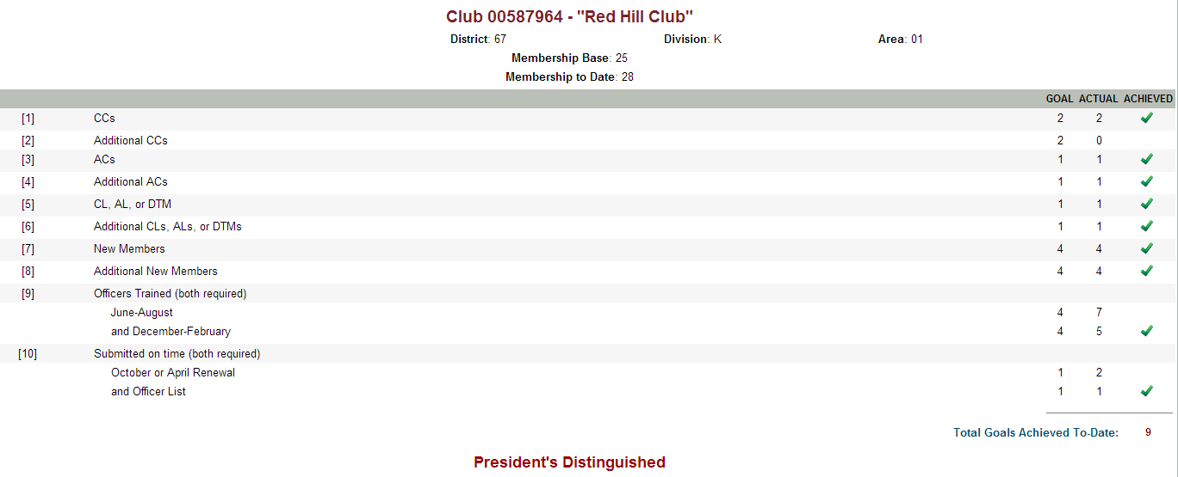
Distinguished Club Program
GOAL RECOGNITION
Achieve any 5 of 10 goals Distinguished Club
Achieve any 7 of 10 goals Select Distinguished Club
Achieve any 9 of 10 goals President's Distinguished Club
www.toastmasters.org
Notes:
So now that we have seen the new look of Toastmasters – what is a club’s role in the Toastmasters brand refresh?

Slide 36
總會網站實用資源分享
www.toastmasters.org
Notes:
So now that we have seen the new look of Toastmasters – what is a club’s role in the Toastmasters brand refresh?

Slide 37
品牌入口
www.toastmasters.org/brandportal
手冊 (PDF) | 名片範本
會議議程 | 教育訓練素材
影片 | 品牌 Logo
網站素材 | 簡報範本
傳單範本 | 照片素材
www.toastmasters.org
Notes:
One of the questions Toastmasters often received is “How can clubs maintain their individuality if they must follow the brand?” The short answer is that you can do both. The Virtual Brand Portal provides you with a templates and guidelines for the visual and verbal system to create your materials. Within the system there is a complete color palette, graphic elements and target messaging that you can use how you wish. You can still apply creativity while staying within the brand guidelines.

Slide 38
品牌 Logo
www.toastmasters.org
Notes:
The Toastmasters logo is the foundation of our visual system – as you can see it is not a complete departure from the globe emblem – but an evolution.
Specifically, continents have been removed to equally represent the 116 countries where Toastmasters meet. The globe implies worldwide presence and the tilt of the latitude and longitude lines implies motion.
We’ve used strong colors intentionally to move away from the more subdued lighter blues and yellows of the past.
This logo can be used in 2 ways – by using the wordmark or the complete logo. Please note that the globe treatment can never be used without the wordmark.
A question you may be wondering is “Are we abandoning the globe emblem?” The answer is no. The globe emblem will always be a part of Toastmasters. It will be the seal – used on the backs of manuals and other official documents.
The new logo and wordmark will be at the forefront of our brand.

Slide 39
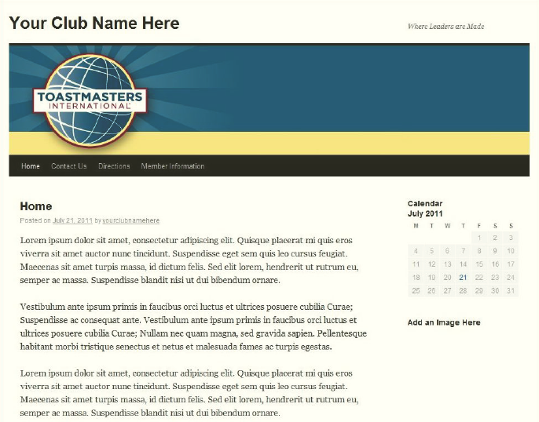
網站素材
www.toastmasters.org
Notes:
Websites. FreeToastHost has made it an easy flip to transition club websites. In addition Toastmasters has provide Google and Wordpress themes which you can see above. All websites should be more simplistic and use one of three special club mastheads for their websites. More information about websites can be found on the Brand Portal – toastmasters.org/brandportal.

Slide 40
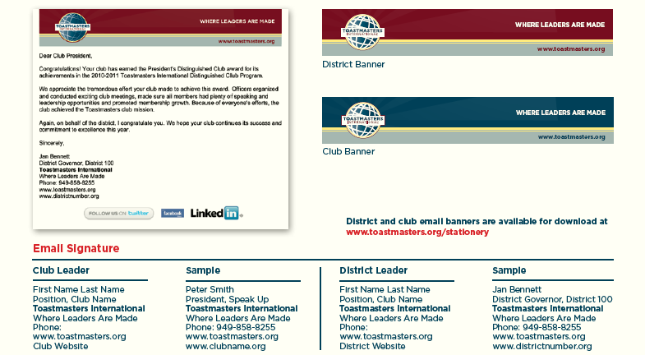
Online Banners and E-mail
www.toastmasters.org
Notes:
Email banner and email signature guidelines. When communicating to members and prospective members via email, be sure to include this email banner and format your signature to follow these guidelines. You can download these graphics from the brand portal on the Toastmasters website.

Slide 41
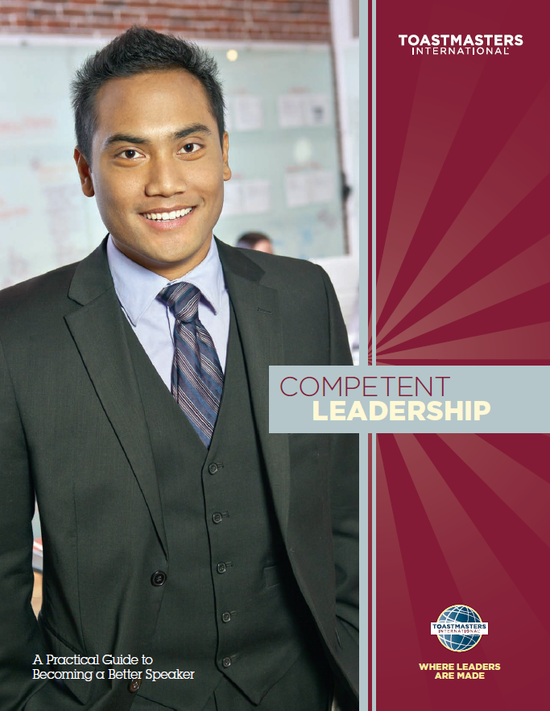
數位版手冊與雜誌
www.toastmasters.org
Notes:
Sample manual covers
Toastmasters has developed a color-coding system so that members can easily identify the education program:
Burgundy – leadership
Blue – communication
In addition, materials for clubs are the blue color, and materials for districts are burgundy.
This system is used across all manuals, badges, pins and other collateral pieces.

Slide 42
簡報範本
www.toastmasters.org
Notes:
PowerPoint Template. Use this template for your presentations to membership. Ideal for training and open house information.

Slide 43
信紙或名片範本
www.toastmasters.org
Notes:
Stationery. Download newly branded letterhead and business card templates from the brand portal.

Slide 44
小手冊或傳單範本
www.toastmasters.org

Slide 45
領袖的搖籃
Where Leader
Are Made
Notes:
Toastmasters International Where Leaders Are Made - will be the tagline moving forward. Different from a theme, this is an enduring message of who we are today. It will not change from year to year.
“In order to accomplish our mission, Toastmasters members, clubs and districts must provide one single, consistent message that demonstrates what Toastmasters is and what we offer the world.” – Toastmasters International President Michael Notaro, DTM
For many years, Toastmasters has been synonymous with public speaking, However the powerful combination of strengthening one’s competence in communication and building leadership skills through participation in Toastmasters is what differentiates Toastmasters International from other skill-building programs. The new official tagline, “Where Leaders Are Made,” reflects this synergy between communication and leadership. Toastmasters training helps members build their competence in communication so they can gain the confidence to speak effectively and lead others.
It is important that we all understand what this tagline means. It is not intended to summarize the entire member experience; rather, it represents what differentiates Toastmasters. It tells members and potential members what makes Toastmasters different from any other option they could choose to grow their communication and leadership skills.
By consistently implementing this tagline along with the supporting brand positioning messages and imagery, you convey to the world that Toastmasters owns that place where members join and gain confidence in public speaking and communication. That confidence often gives them the strength to lead. Regardless of whether a Toastmaster has chosen to become a leader or not, but the mere fact that they are strong, clear and confident communicators, they are often naturally sought out as mentors, advisors and leaders.

Slide 46
謝謝各位
Notes:
Thanks for your time, I’d like to conclude this presentation and answer any questions you may have. For those questions I cannot answer I’ll direct the inquiries to World Headquarters – brand@toastmasters.org.

